Slide 1
Access Networks: Troubleshooting
Nick Feamster
CS 6250
Fall 2011

Slide 2
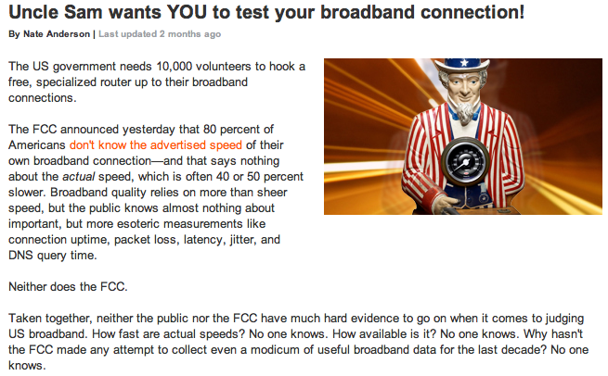
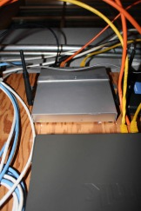
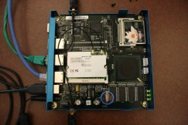


Home Networking & Access Networks
Problems
  Performance problems are difficult to debug
  Access ISPs discriminate, give poor performance
  Hard to manage, troubleshoot, secure
Research
  Programmable gateways in homes
  Perform active and passive measurements
  Collect information about user behavior
  Remotely control, troubleshoot, and secure
Notes:
Home networks are difficult for experts to debug, let alone average home users. As we have recently seen in the news, the Federal Communications Commission has also taken an interest in benchmarking access ISP performance in the US, pursuing a deployment of measurement devices in more than 10,000 homes across the country to measure access network performance from various vantage points. We are collaborating with the FCC in this effort: we have analyzed a similar dataset for home network users in France and are now cooperating with the FCC to deploy programmable gateways in homes around the United States. These boxes (shown on the slide) perform a combination of active and passive measurements of both the access link, and of performance inside the home. This allows us to answer interesting questions such as: Where is the cause of performance degradation that a home user is experiencing (e.g., on the access link or inside the home)? We are also collaborating with professors in HCI (Keith Edwards) to understand user behavior (e.g., how users respond to poor performance).

Slide 3
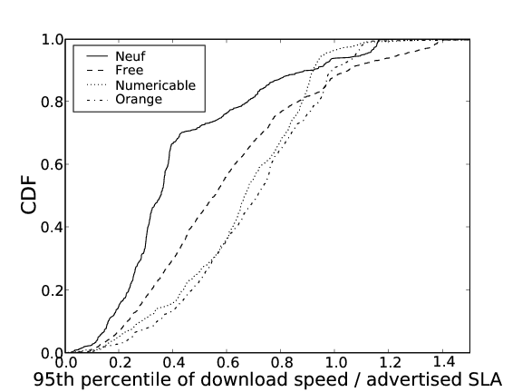
User Performance is Poor
Fewer than half of the users achieve 80% of advertised SLA. Why?
Cumulative fraction of users
95th percentile of download speeds / advertised SLA
S. Sundaresan, L. Di Cioccio, N. Feamster, R. Teixeira. “Which Factors Affect Home Network Performance?”

Slide 4
We Know Very Little
User performance does not match advertised rates
We have very little idea why
  We don’t even know how many performance problems occur due to problems inside vs. outside the home
We have no idea how users react when performance suffers
Notes:
Add a diagram from Beki/Keith’s networking papers

Slide 5
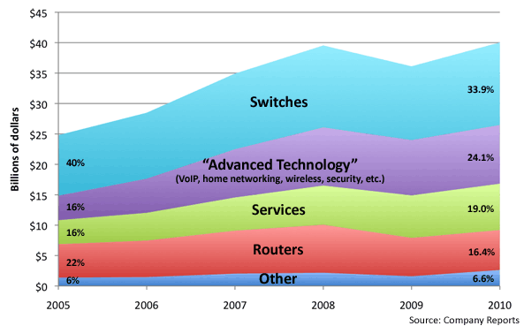
Future: “User Proof” Networks
Hide complexity
from the user
  Improve
  interfaces
Outsource
management to
third party
Usage model
  Users plug devices into home network gateway (or associate via wireless)
  Gateway is controlled remotely by third-party software

Slide 6
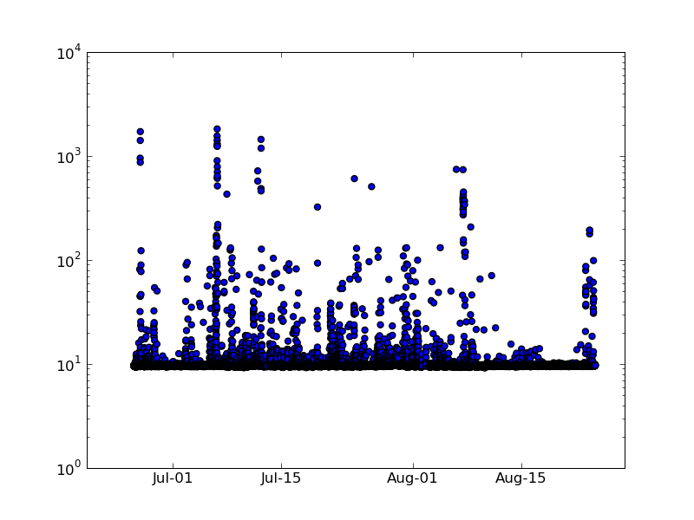
Network Latency Varies Over Time
Round-trip times can vary by up to two orders of magnitude.
Is this caused by the access link or the home user?

Slide 7
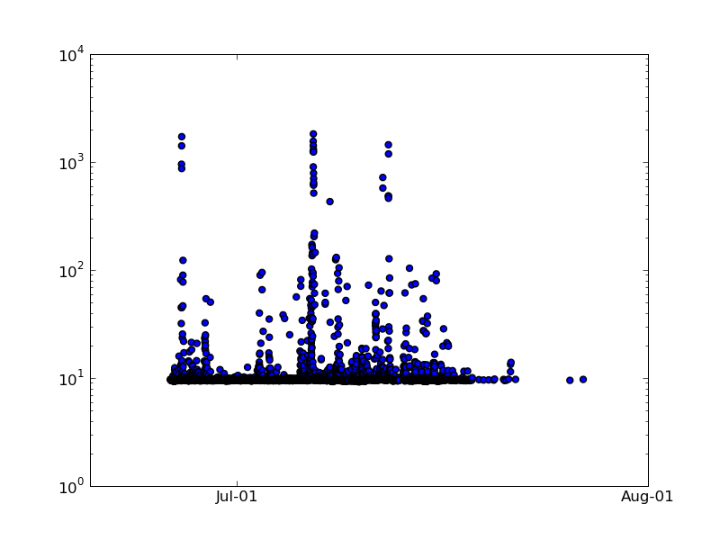
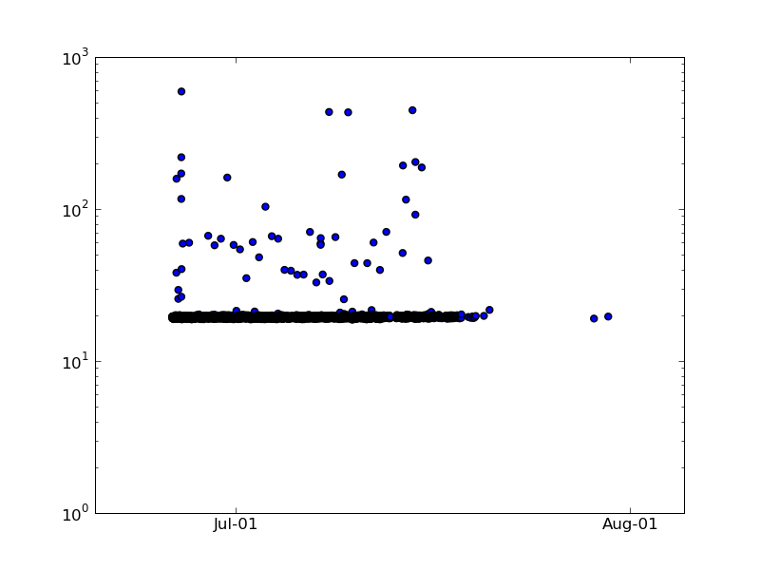
Network Latency Varies by User
Baseline Round-Trip Time Varies by about 20 milliseconds.
Homes about two blocks apart.

Slide 8
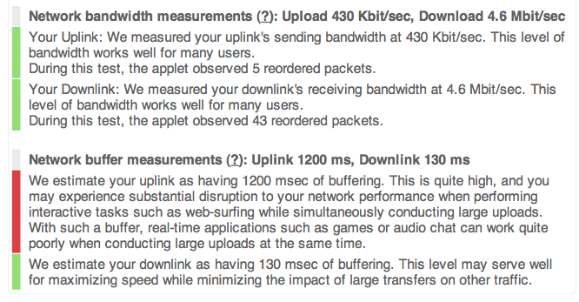
One Approach: Netalyzr

Slide 9
Netalyzr Data
130,000 runs of the system from 99,000 public IP addresses
Findings
  Over-buffering of links
  Inability to handle fragmentation
  Incorrectly operating Web caches
  Poor DNS performance

Slide 10
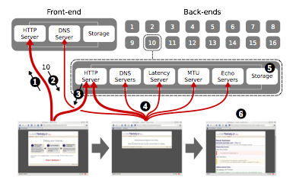
System Design
Tradeoffs
  Flexibility for conducting a wide range of experiments
  Simple enough interface for users to run
Architecture

Slide 11
Netalyzr Measurements
Network-layer Information
  IP Fragmentation
  Path MTU
  Latency, bandwidth, buffering
  IPv6 adoption
Service Reachability
DNS Measurements

Slide 12
DNS Measurements
Check the acceptance of arbitrary A records
Check whether the server will follow CNAME
Server identification
  Resolver identity
  0x20 support
  Respect for short TTLs
  Whether the user’s NAT is proxying DNS

Slide 13
HTTP Measurements
Proxy detection
Caching policies, transcoding, file-type blocking

Slide 14
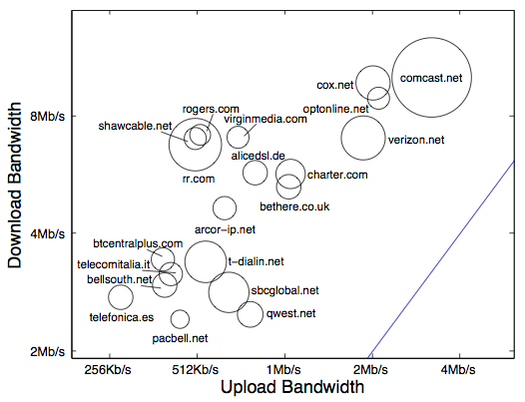
Results: Throughput

Slide 15
Network-Layer Results
NATs are prevalent: 90% of all sessions
NAT often does not preserve the source port number for connections
Only 4.8% of sessions supported IPv6
Fragmentation not reliable: 8% no support
Buffering in DSL or DOCSIS cable modems
  250ms of additional latency during file transfers for 256 KB buffer, 8 Mbps up. >1 second for slower links.

Slide 16
DNS Results
0x20 deployment is scarce
42% of sessions with a Linux-related user agent requested AAAA (IPv6) records
Prevalence of EDNS/DNSSEC resolvers
29% of resolvers had NXDOMAIN wildcarding

Slide 17
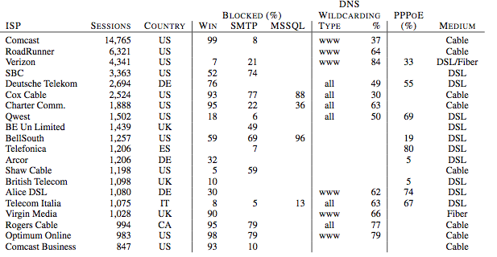
ISP Policies

Slide 18
NetPrints:
Diagnosing Home Network Misconfigurations using Shared Knowledge
Bhavish Aggarwal, Ranjita Bhagwan,
Tathagata Das, Venkat Padmanabhan
Microsoft Research India
Siddharth Eswaran, IIT Delhi
Geoff Voelker, UCSD
Notes:
Need to change:
Add change tree/config trees
Add correct metric for mutation algorithm.
Add more on tree learning? C4.5 slide?

Slide 19



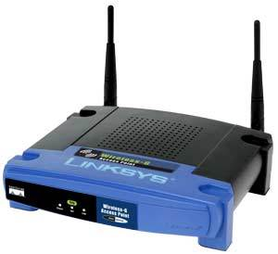
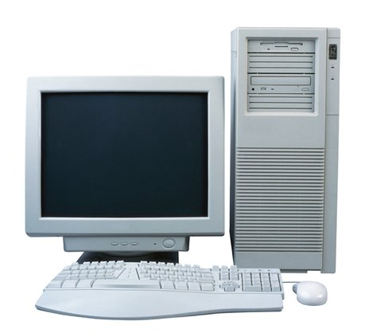



Typical Home Network
Email
IM
Browser
Internet
Torrents
Server
Email
VPN client
Game hosting
IM
Multiplayer
No network admin!

Slide 20
Examples of Problems
Problem | Solution
VPN client does not connect from home | Turn on PPTP passthrough on router, use a subnet that is either 192.168.0.x or 192.168.1.x
XBOX doesn’t connect to the Live service | Turn up your MTU above 1365, change NAT settings to full-cone, turn on UPnP
My IM client doesn’t work from home | Turn off the DNS proxy on the router
File sharing doesn’t seem to work at home | Make sure you and the file server are on the same domain/workgroup.
Printing doesn’t work from my laptop | Turn on correct firewall rules on print server machine
Cannot send large emails | Turn down MTU on your router
Router misconfig
End-host
misconfig
Remote problem, local changes
Diversity ⇒ home network troubleshooting is hard
Notes:
Say “router” problem, “client” problem, “hidden configuration” … animate

Slide 21
What Do Users Do Today?
Source: Managing the Digital Home, a survey of 6,116 U.S. and Canadian home Internet users
© 2007 Parks Associates
Avg time to resolve solutions: 2 hours

Slide 22
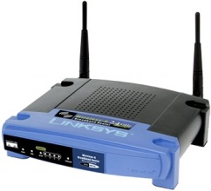
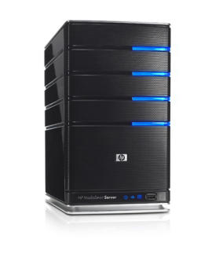

NetPrints
NetPrints = Network Problem Fingerprinting
Automate problem diagnosis using “shared knowledge”
NetPrints Service
Configuration info
Configuration info
Configuration info
Configuration info
Suggested changes
Notes:
Netprints: network fingerprints?

Slide 23
Putting NetPrints in Context
Rule-based techniques
Tracing, Learning-based
Windows Diagnostics Framework
Network Magic
Apple’s Diagnostics
Strider+PeerPressure
Autobash
SVM-based performance debugger
Resolve basic connectivity issues
(Application specific: too many rules)
Resolve local configuration issues
NetPrints
Distributed configuration information
Unstructured, heterogeneous environment
Problems caused due to interaction of multiple configurations
Notes:
Do not undersell … say what is new in netprints: configuration info is distributed, unstructured, interactions cause new problems, new learning techniques. Add stuff to the slide

Slide 24
Assumptions
Current design requires basic connectivity
  Looking at application-specific problems
  Not inherent, Knowledgebase can be shipped offline
Not dealing with performance
  “good” and “bad” are the only two states considered

Slide 25
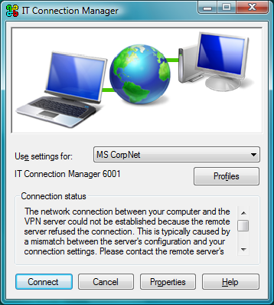
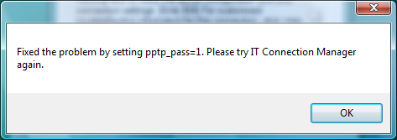
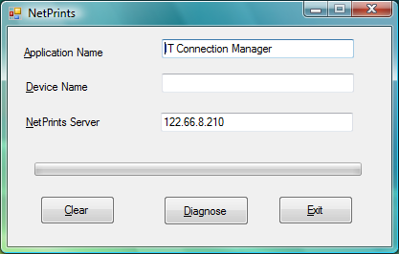
NetPrints in Action
Suggest.xml
pptp_pass=1
Config.xml
…
pptp_pass=0
…
Knowledgebase for VPN client
NetPrints
server
Notes:
Add labs, arrow animations

Slide 26
Diagnosis Strategies
Snapshot-based
  Collect config snapshots from different users
Change-based
  Collect config changes that a user makes
Symptom-based
  Collect signatures of problems from network traffic

Slide 27
System Design
NetPrints Client
NetPrints Server
Config
Scraper
(End-host
& Router)
Network Feature Extractor
Server Knowledgebase
Config trees
Change trees
Sig-
natures
GUI
Diagnosis engine
Local-Area
Network
Internet
Internet Gateway Device
Notes:
Change colour scheme (remove 3d)

Slide 28
Normal Mode
NetPrints Client
NetPrints Server
Config
Scraper
(End-host
& Router)
1. Config
Scraper
(End-host
& Router)
Network Feature Extractor
2. Network Feature Extractor
5. Server Knowledgebase
Server Knowledgebase
Config trees
Config trees
Change trees
Change trees
Sig-
natures
Sig-
natures
GUI
GUI
3. GUI
Diagnosis engine
Local-Area
Network
4. Send data to server
Internet
Internet Gateway Device
Notes:
Change colour scheme (remove 3d)

Slide 29
Diagnose Mode
NetPrints Client
NetPrints Server
Config
Scraper
(End-host
& Router)
2. Config
Scraper
(End-host
& Router)
Network Feature Extractor
3. Network Feature Extractor
Server Knowledgebase
Server Knowledgebase
Config trees
Config trees
Change trees
Change trees
Sig-
natures
Sig-
natures
GUI
GUI
1. GUI
Diagnosis engine
5. Diagnosis engine uses configuration mutation
Local-Area
Network
4. Send data to server
Internet
Internet Gateway Device
Notes:
Change colour scheme (remove 3d)

Slide 30
#1: Configuration Scraper
Router scraper
  UPnP
  Web Interface (HTTP Request Hijacking)
End-host scraper
  Interface-specific parameters
  Patches and software versions
  Firewall rules
Remote scraper
  Composition of local and remote configs

Slide 31
Composing Local & Remote Configs
Problem | Solution
VPN client does not connect from home | Turn on PPTP passthrough on router, use a subnet that is either 192.168.0.x or 192.168.1.x
XBOX doesn’t connect to the Live service | Turn up your MTU above 1365, change NAT settings to full-cone, turn on UPnP
My IM client doesn’t work from home | Turn off the DNS proxy on the router
File sharing doesn’t seem to work at home | Make sure client and the server are on the same domain/workgroup.
Printing doesn’t work from my laptop | Turn on correct firewall rules on print server machine
Cannot send large emails | Turn down MTU on your router
Sometimes it is the combination of local and remote configs that is the problem
Notes:
Comparison engine ?

Slide 32
#2: Server Knowledgebase
Per-application decision trees constructed using labeled configuration snapshots
  decision trees aid interpretability
  C4.5 decision tree learning algorithm
Configuration tree, Change trees and network signatures

Slide 33
Methodology
Testbed comprising 7 different routers
  various makes: Netgear, Linksys, D-Link, Belkin
Clients running the VPN sent configurations to the NetPrints service
  Roughly 6000 config parameters per snapshot
Service learned configuration trees using C4.5 algorithm

Slide 34
Example of Configuration Tree
pptp_pass
0
1
device
device
Netgear
Linksys
Netgear
Linksys
disable_spi
bad
disable_spi
good
0
1
0
1
good
bad
good
bad
Simplified Config Tree for VPN Client
Notes:
Lookup ndf helper class… who calls what?

Slide 35
Configuration Tree for VPN Client
local.disable_spi
0
1
NA
Good (50/1)
Bad (48/0)
local.pptp_pass
0
1
NA
local.filter
Good (49/0)
Good
(73/0)
off
on
NA
local.ethernet.speed
Bad
(54/0)
Bad
(12/0)
1Gbps
100Mbps
Good
(42/0)
local.dmz_enable
0
1
local.ipsec_pass
Good
(4/0)
0
1
local.l2tp_pass
Bad
(4/0)
0
1
Good
(2/0)
Bad
(2/0)

Slide 36
#3: Configuration Mutation
Track change frequency.
device=Linksys
pptp_pass=0
pptp_pass
1000
0
1
device
10
device
10
Netgear
Linksys
Netgear
Linksys
2000
disable_spi
bad
2000
disable_spi
good
0
1
0
1
good
bad
good
bad
Preference for mutations involving frequently changing parameters
Assumption: higher the frequency, less disruptive the change
Notes:
Write the algorithm better. Press the better button.

Slide 37
Shortcoming of Configuration Trees
Some config info may not be learned
So traversal of config tree may end in a “good” leaf even if config is problematic
Reasons:
  Insufficient data
    e.g., a new router enters the market
  Hidden configurations
    e.g., application-specific parameters
Notes:
Talk about only one hidden conf

Slide 38
Summary of Diagnosis Procedure
Configuration tree
Network traffic signature | Change trees
1 X X X X X X
0 X X X X 1 X
Notes:
Rearrange slide 20 and 19.

Slide 39
Experimental Evaluation
Testbed comprising 7 different routers
  various makes: Netgear, Linksys, D-Link, Belkin
VPN Client
FTP Server
File Share
Internet
VPN Server
Internet
FTP Client
Internet
File Share
HOME
HOME
HOME

Slide 40
Findings
Intuitive inferences
  VPN: If pptp_pass==1 then GOOD
Surprising inferences
  VPN: If stateful==off and pptp_pass==0 and ipsec_pass==0 and l2tp_pass==0 then GOOD

Slide 41
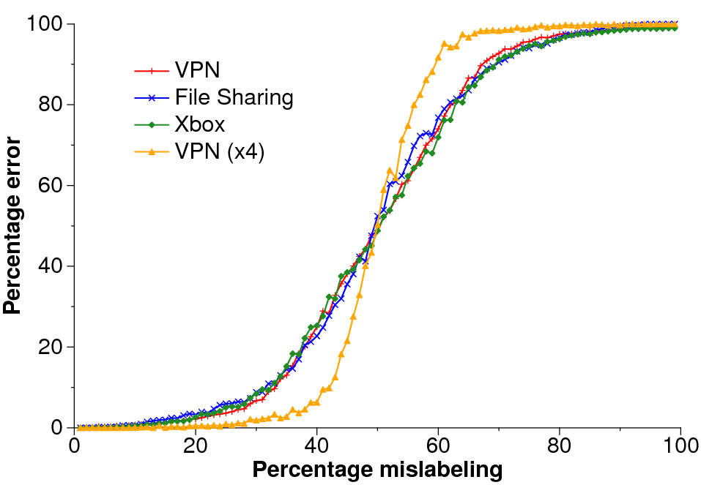
Tolerance to Mislabeling
  13-17% mislabeling ⇒ 1% error in diagnosis

Slide 42
Tolerance to Mislabeling
  13-17% mislabeling ⇒ 1% error in diagnosis

Slide 43
Summary
Home network diagnostics is challenging
  diversity of apps and configs
  absence of an admin
NetPrints leverages community info to perform automated diagnosis
  decision tree based learning
  configuration trees, network traffic signatures and change trees
Notes:
Get prototype to a working state … say that they asked for code by november.

