Slide 1
Network Configuration Management
Nick Feamster
CS 6250: Computer Networking
Fall 2011
(Some slides on configuration complexity from Prof. Aditya Akella)

Slide 2
The Case for Management
Remote User
Typical problem
  Remote user arrives at regional office and experiences slow or no response from corporate web server
Where do you begin?
  Where is the problem?
  What is the problem?
  What is the solution?
Without proper network management, these questions are difficult to answer
Regional Offices
WWW Servers
Corp Network

Slide 3
The Case for Management
Remote User
With proper management tools and procedures in place, you may already have the answer
Consider some possibilities
  What configuration changes were made overnight?
  Have you received a device fault notification indicating the issue?
  Have you detected a security breach?
  Has your performance baseline predicted this behavior on an increasingly congested network link?
Regional Offices
WWW Servers
Corp Network

Slide 4
Problem Solving
An accurate database of
your network’s topology, configuration, and performance
A solid understanding of the protocols and models used in communication between your management server and the managed devices
Methods and tools that allow you to interpret and act upon gathered information
Response Times
High Availability
Security
Predictability

Slide 5
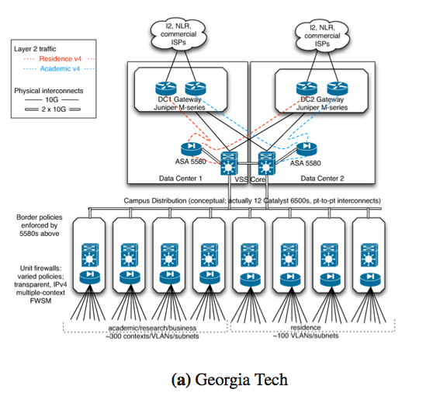
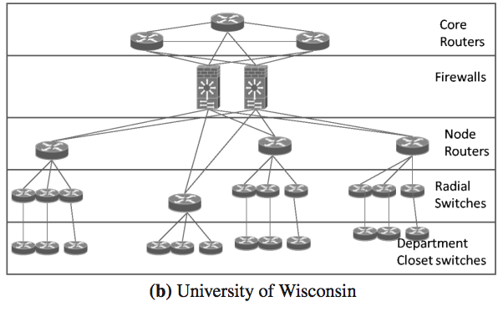
Network Configuration

Slide 6
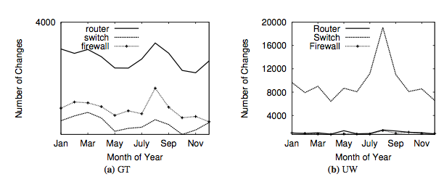
Configuration Changes Over Time
Many security-related changes (e.g., access control lists)
Steadily increasing number of devices over time

Slide 7
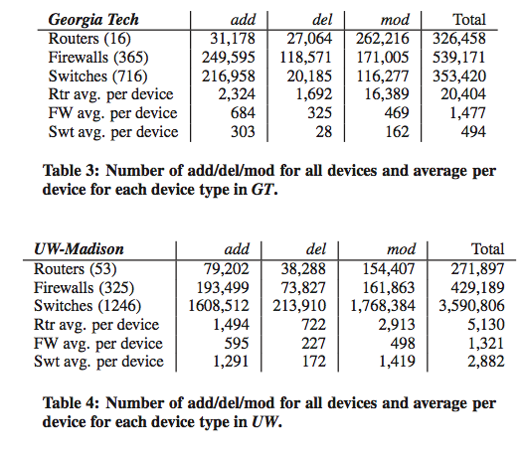
Configuration Changes Over Time

Slide 8
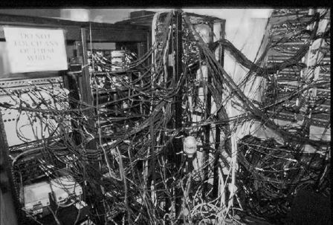
Modern Networks are Complex
Intricate logical and physical topologies
Diverse network devices
  Operating at different layers
  Different command sets, detailed configuration
Operators constantly tweak
network configurations
  New admin policies
  Quick-fixes in response to crises
Diverse goals
  E.g. QOS, security, routing, resilience
Complex
configuration
Notes:
Enterprises networks are a patch work of devices acquired over time
As such the networks contain intricate logical and physical topologies.
These diverse collection of devices operate at different levels and often require different control/configuration interface making it difficult to reason about how changes are affect other portions of the network.
To complicate matters, most changes are time sensitive and are performed with least amount of planning required: examples of such changes are:
Network patches to counter crises such as worm or viral outbreaks.
Or implementation of new administrative policies such as prevent of traffic sharing apps
The constant change and division of diverse devises makes the configuration of enterprise network complex

Slide 9
Changing Configuration is Tricky
Adding a new department with hosts spread across 3 buildings (this is a “simple” example!)
Interface vlan901
ip address 10.1.1.2 255.0.0.0
ip access-group 9 out
!
Router ospf 1
router-id 10.1.2.23
network 10.0.0.0 0.255.255.255
!
access-list 9 10.1.0.0 0.0.255.255
Interface vlan901
ip address 10.1.1.5 255.0.0.0
ip access-group 9 out
!
Router ospf 1
router-id 10.1.2.23
network 10.0.0.0 0.255.255.255
!
access-list 9 10.1.0.0 0.0.255.255
Interface vlan901
ip address 10.1.1.8 255.0.0.0
ip access-group 9 out
!
Router ospf 1
router-id 10.1.2.23
network 10.0.0.0 0.255.255.255
!
access-list 9 10.1.0.0 0.0.255.255
Opens up a hole
Department1
Department1
Department1
Notes:
one common example: of how a large network might be changed:
Adding a new department that is homed in 3 different buildings – each building has a different gateway router.
To correctly grant network access for the whole department the config for each of the three routers must be updated.
If the operators fails to update one config, then the hosts in that building are denied access
Similarly if the operator sets up the interface for the hosts but fails to set up routing on a particular router then access is denied

Slide 10
Getting a Grip on Complexity
Complexity → misconfiguration, outages
Can’t measure complexity today
  Ability to predict difficulty of future changes
Benchmarks in architecture, DB, software engineering have guided system design
Metrics essential for designing manageable networks
No systematic way to mitigate or control complexity
Quick fix may complicate future changes
  Troubleshooting, upgrades harder over time
Hard to select the simplest from alternates
Complexity
of n/w design
#1 #2 #3
Options for making a change
or for ground-up design
Notes:
The community has long attributed complexity as the cause for misconfiguration in enterprise networks, however we have yet to produce tools to quantify complexity. software engineering and protocol design, both communities with similar concerns, have come up with metric to quantify complexity --- these metrics have proved helpful in choosing systems.
Without a way to measure complexity it is difficult to understand the impact of changes

Slide 11

Measuring and Mitigating Complexity
Metrics for layer-3 static configuration [NSDI 2009]
  Succinctly describe complexity
    Align with operator mental models, best common practices
  Predictive of difficulty
    Useful to pick among alternates
  Empiricial study and operator tests for 7 networks
    Network-specific and common
Network redesign (L3 config)
  Discovering and representing policies [IMC 2009]
    Invariants in network redesign
  Automatic network design simplification [Ongoing work]
    Metrics guide design exploration
(1) Useful to pick among alternates
Metrics
Complexity
of n/w design
#1 #2 #3
Options for making a change
or for ground-up design
Many routing process
with minor differences
Few consolidated
routing process
(2) Ground-up simplification
Notes:
04/23
Mental models ops use when managing their networks
Examine operator best practices and through interviews we develop metrics that
..succinctly ….. by Abstract away details makes it language independent
.. Can be automatically calculated from static config allowing comparisons between two versions as is often the case
.. Capture design complexity for layer 3, the layer operators found most challenging
.. We show later that these metrics align with operator mental model meaning it can predict difficulty of future changes
we eval out metrics on conf of 7 network and validated approach through operator interviews. Giving questions and timing standardized operational tasks

Slide 12
Services
VPN: Each customer gets a private IP network, allowing sites to exchange traffic among themselves
VPLS: Private Ethernet (layer-2) network
DDoS Protection: Direct attack traffic to a “scrubbing farm”
Virtual Wire: Point-to-point VPLS network
VoIP: Voice over IP

Slide 13
MPLS Overview
Main idea: Virtual circuit
  Packets forwarded based only on circuit identifier
Source 1
Destination
Source 2
Router can forward traffic to the same destination on different interfaces/paths.

Slide 14
Circuit Abstraction: Label Swapping
D
A
1
2
Tag Out New
3
A
2
D
Label-switched paths (LSPs): Paths are “named” by the label at the path’s entry point
At each hop, label determines:
  Outgoing interface
  New label to attach
Label distribution protocol: responsible for disseminating signalling information

Slide 15
Layer 3 Virtual Private Networks
Private communications over a public network
A set of sites that are allowed to communicate with each other
Defined by a set of administrative policies
  determine both connectivity and QoS among sites
  established by VPN customers
  One way to implement: BGP/MPLS VPN mechanisms (RFC 2547)

Slide 16
Building Private Networks
Separate physical network
  Good security properties
  Expensive!
Secure VPNs
  Encryption of entire network stack between endpoints
Layer 2 Tunneling Protocol (L2TP)
  “PPP over IP”
  No encryption
Layer 3 VPNs
Privacy and interconnectivity (not confidentiality, integrity, etc.)

Slide 17
Layer 2 vs. Layer 3 VPNs
Layer 2 VPNs can carry traffic for many different protocols, whereas Layer 3 is “IP only”
More complicated to provision a Layer 2 VPN
Layer 3 VPNs: potentially more flexibility, fewer configuration headaches

Slide 18
Layer 3 BGP/MPLS VPNs
VPN A/Site 2
10.2/16
VPN B/Site 1
10.2/16
CE¹_{B1}
CE_{A2}
10.1/16
CE_{B2}
VPN B/Site 2
P₁
PE₂
CE²_{B1}
P₂
BGP to exchange routes
MPLS to forward traffic
PE₁
PE₃
CE_{A1}
P₃
CE_{A3}
10.3/16
CE_{B3}
10.1/16
VPN A/Site 3
VPN A/Site 1
10.4/16
VPN B/Site 3
Isolation: Multiple logical networks over a single, shared physical infrastructure
Tunneling: Keeping routes out of the core

Slide 19
High-Level Overview of Operation
IP packets arrive at PE
Destination IP address is looked up in forwarding table
Datagram sent to customer’s network using tunneling (i.e., an MPLS label-switched path)

Slide 20
BGP/MPLS VPN key components
Forwarding in the core: MPLS
Distributing routes between PEs: BGP
Isolation: Keeping different VPNs from routing traffic over one another
  Constrained distribution of routing information
  Multiple “virtual” forwarding tables
Unique addresses: VPN-IP4 Address extension

Slide 21
Virtual Routing and Forwarding
Separate tables per customer at each router
Customer 1
10.0.1.0/24
10.0.1.0/24
RD: Green
Customer 1
Customer 2
10.0.1.0/24
Customer 2
10.0.1.0/24
RD: Blue

Slide 22
Routing: Constraining Distribution
Performed by Service Provider using route filtering based on BGP Extended Community attribute
  BGP Community is attached by ingress PE route filtering based on BGP Community is performed by egress PE
BGP
Site 2
Static route, RIP, etc.
RD:10.0.1.0/24
Route target: Green
Next-hop: A
Site 1
A
10.0.1.0/24
Site 3

Slide 23
BGP/MPLS VPN Routing in Cisco IOS
Customer A
Customer B
ip vrf Customer_A
rd 100:110
route-target export 100:1000
route-target import 100:1000
!
ip vrf Customer_B
rd 100:120
route-target export 100:2000
route-target import 100:2000

Slide 24
Forwarding
PE and P routers have BGP next-hop reachability through the backbone IGP
Labels are distributed through LDP (hop-by-hop) corresponding to BGP Next-Hops
Two-Label Stack is used for packet forwarding
  Top label indicates Next-Hop (interior label)
  Second level label indicates outgoing interface or VRF (exterior label)
Corresponds to LSP of
BGP next-hop (PE)
Corresponds to VRF/interface at exit
Layer 2 Header
Label
1
Label
2
IP Datagram

Slide 25
Forwarding in BGP/MPLS VPNs
Step 1: Packet arrives at incoming interface
  Site VRF determines BGP next-hop and Label #2
Label
2
IP Datagram
Step 2: BGP next-hop lookup, add corresponding LSP (also at site VRF)
Label
1
Label
2
IP Datagram

Slide 26
Measuring Complexity

Slide 27
Two Types of Design Complexity
Implementation complexity: difficulty of implementing/configuring reachability policies
  Referential dependence: the complexity behind configuring routers correctly
  Roles: the complexity behind identifying roles (e.g., filtering) for routers in implementing a network’s policy
Inherent complexity: complexity of the reachability policies themselves
  Uniformity: complexity due to special cases in policies
  Determines implementation complexity
    High inherent complexity → high implementation complexity
    Low inherent complexity → simple implementation possible
Notes:
Our metrics capture imple and inhe complexity …..
Imple → two sets of metrics

Slide 28
Naïve Metrics Don’t Work
Size or line count not a good metric
  Complex
  Simple
Need sophisticated metrics that capture configuration difficulty
Networks | Mean file size | Number of routers
Univ-1 | 2535 | 12
Univ-2 | 560 | 19
Univ-3 | 3060 | 24
Univ-4 | 1526 | 24
Enet-1 | 278 | 10
Enet-2 | 200 | 83
Enet-3 | 600 | 19
Notes:
To validate our metrics we studied the configuration files of 7 networks and operators for 5 of the networks.
Of the 7 networks we studied, 4 were University and 3 were commercial enterprise network.
Networks varied in size; both size of the configuration files and the number of users supported. The complexity of the various networks is unrelated to the size

Slide 29
Referential Complexity:
Dependency Graph
An abstraction derived from router configs
Intra-file links, e.g., passive-interfaces, and access-group
Inter-file links
  Global network symbols, e.g.,
  subnet, and VLANs
1 Interface Vlan901
2 ip 128.2.1.23 255.255.255.252
3 ip access-group 9 in
4 !
5 Router ospf 1
6 router-id 128.1.2.133
7 passive-interface default
8 no passive-interface Vlan901
9 no passive-interface Vlan900
10 network 128.2.0.0 0.0.255.255
11 distribute-list in 12
12 redistribute connected subnets
13 !
14 access-list 9 permit 128.2.1.23 0.0.0.3 any
15 access-list 9 deny any
16 access-list 12 permit 128.2.0.0 0.0.255.255
ospf 1
ospf1
Route-map 12
Vlan30
Vlan901
Access-list 12
Access-list 10
Access-list 11
Subnet 1
Access-list 9
Notes:
Dependency graph – an abstraction de

Slide 30
Referential Dependence Metrics
Operator’s objective: minimize dependencies
  Baseline difficulty of maintaining reference links network-wide
  Dependency/interaction among units of routing policy
Metric: # ref links normalized by # devices
Metric: # routing instances
  Distinct units of control plane policy
    Router can be part of many instances
    Routing info: unfettered exchange
    within instance, but filtered across
    instances
  Reasoning about a reference harder
  with number/diversity of instances
    Which instance to add a reference?
    Tailor to the instance
Notes:
Operators tell us that …
Change to one but not the others introduces a bug. Because the configs do not explicitly declare, best to minimize them
04/23 – R.I. → routing difficulty because it affects certain routing related changes [reword]
Metric is the # of ref links in the network, higher number means greater complexity. To allow comparisons we normalize by ref link count to produce 2 numbers. First we normalize by # device to get a holistic view of the network. Second we normalize by r.i. to determine difficult of configuring routing.
Operators partion r.p. to provide better control, each partition is a r.i. We provide simple network with 4 router and 3 r.i. As can be seen router can belong in multiple r.i. and a r.i. can contain only one router.
Ref links are not just links between routers but also links within the routers

Slide 31
Empirical Study of Implementation Complexity
No direct relation to network size
  Complexity based on implementation details
  Large network could be simple
Network (#routers) | Avg ref links per router | #Routing instances
Univ-1 (12) | 42 | 14
Univ-2 (19) | 8 | 3
Univ-3 (24) | 4 | 1
Univ-4 (24) | 75 | 2
Enet-1 (10) | 2 | 1
Enet-2 (83) | 8 | 10
Enet-3 (19) | 22 | 8
Notes:
Results are not uniform
Biggest has lowest complexity, third smallest has largest complexity.
Complexity not a function of network size but rather aspects of config files
Next operator interview to determine some causes

Slide 32
Metrics ⇒ Complexity
Task: Add a new subnet at a randomly chosen router
Network | Avg Ref links per router | #Routing instances
Univ-1 (12) | 42 | 14
Univ-3 (24) | 4 | 1
Enet-1 (10) | 2 | 1
Num steps | #changes to routing
4-5 | 1-2
4 | 0
1 | 0
Enet-1, Univ-3: simple routing → redistribute entire IP space
Univ-1: complex routing → modify specific routing instances
  Multiple routing instances add complexity
Metric not absolute but higher means more complex
Notes:
Give
Add/remove subnet
Apply new filter to a collection of interfaces

Slide 33
Inherent Complexity
Reachability policies determine a network’s configuration complexity
  Identical or similar policies
    All-open or mostly-closed networks
    Easy to configure
  Subtle distinctions across groups of users
    Multiple roles, complex design, complex referential profile
    Hard to configure
Not “apparent” from configuration files
  Mine implemented policies
  Quantify similarities/consistency
Notes:
Complexity of configuring the policies that a network is trying to implement. But what about the complexity of the policies themselves.
Quantify the complexity of the policies the network is trying to implement.
Complexity of implementing stuff in the network. Instantiating and maintaing roles,
Why challengin

Slide 34

Reachability Sets
Networks policies shape packets exchanged
  Metric: capture properties of sets of packets exchanged
Reachability set (Xie et al.): set of
packets allowed between 2 routers
  One reachability set for each pair of routers (total of N² for a network with N routers)
  Affected by data/control plane mechanisms
Approach
  Simulate control plane
  Normalized ACL representation for FIBs
  Intersect FIBs and data plane ACLs
FIB → ACL
FIB → ACL
Notes:
An operators goal is to establish a certain level or connectivity between hosts in the network. Reachability sets allow us to capture the set of packets allowed between any 2 routers in the network; reachability sets reflect the connectivity between routers and thus capture the established policy

Slide 35
Inherent Complexity: Uniformity Metric
Variability in reachability sets between pairs of routers
Metric: Uniformity
  Entropy of reachability sets
  Simplest: log(N) → all routers should have same reachability to a destination C
  Most complex: log(N²) → each router has a different reachability to a destination C
R(A,C)
A
B
E
R(B,C)
D
C
R(D,C)
R(C,C)
 | A | B | C | D | E
A
B
C
D
E
 | A | B | C | D | E
A
B
C
D
E
Notes:
Track variations in policies – since to do this, we tracks how RSs for different paths differ. Comparing reachability sets in our framework is easy because of normalization. Hashes equal iff reach sets equal. Thus, we compute hashes for all N2 reachability sets in the network and deriving the info theoretic entropy over the hashes.
Recall from our definition of RS that the source addresses in the set can be anything. Dest addresses should belong in a network with very uniform policies all reachability sets with respect to a destination should be the same. Network does not make a distinction between sources in their ability to reach the destination.
In a network with highly non-uniform policies, the reachibility sets could each be different from the other because the network makes fine-grained….
Non-uniformity in the reachability sets across various possible network paths.

Slide 36
Empirical Results
Simple policies
  Entropy close to ideal
Univ-3 & Enet-1: simple policy
  Filtering at higher levels
Univ-1:
  Router was not redistributing local subnet
Network | Entropy (diff from ideal)
Univ-1 | 3.61 (0.03)
Univ-2 | 6.14 (1.62)
Univ-3 | 4.63 (0.05)
Univ-4 | 5.70 (1.12)
Enet-1 | 2.8 (0.0)
Enet-2 | 6.69 (0.22)
Enet-3 | 5.34 (1.09)
Network (#routers) | Avg Ref links per router | #Routing instances
Univ-1 (12) | 42 | 14
BUG!
Notes:
2.Conduct interviews to show that all policies (incl special cases) were capturesed
interview show …
For example, enet-1 have firewalls to restrict testbed traffic from leaving the network
3. During interview

Slide 37
Insights
Networks (#routers) | Ref links | Entropy (diff from ideal)
Univ-1 (12) | 42 | 3.61 (0.03)
Univ-2 (19) | 8 | 6.14 (1.62)
Univ-3 (24) | 4 | 4.63 (0.05)
Univ-4 (24) | 75 | 5.70 (1.12)
Enet-1 (10) | 2 | 2.8 (0.0)
Enet-2 (83) | 8 | 6.69 (0.22)
Enet-3 (19) | 22 | 5.34 (1.09)
Studied networks have complex configuration, But, inherently simple policies
Network evolution
  Univ-1: dangling references
  Univ-2: caught in the midst of a major restructuring
Optimizing for cost and scalability
  Univ-1: simple policy, complex config
  Cheaper to use OSPF on core routers and RIP on edge routers
    Only RIP is not scalable
    Only OSPF is too expensive

Slide 38
(Toward) Mitigating complexity –
Mining policy

Slide 39
Policy Units
Policy units: reachability policy as it applies to users
Equivalence classes over the reachability profile of the network
  Set of users that are “treated alike” by the network
  More intuitive representation of policy than reachability sets
Algorithm for deriving policy units from router-level reachability sets (Akella et al., IMC 2009)
  Policy unit → a group of IPs
Host 1
Host 2
Host 3
Host 4
Host 5
Notes:
Host 1 & 2 same profile
4 policy units

Slide 40
Policy Units in Enterprises
Name | # Subnets | # Policy Units
Univ-1 | 942 | 2
Univ-2 | 869 | 2
Univ-3 | 617 | 15
Enet-1 | 98 | 1
Enet-2 | 142 | 40
Policy units succinctly describe network policy
Two classes of enterprises
  Policy-lite: simple with few units
    Mostly “default open”
  Policy-heavy: complex with many units
Notes:
Policy units succinctly describe network
No correlation between size and units
Two classes of enterprises
Policy-lite: simple with few
Policy-heavy: complex with many

Slide 41
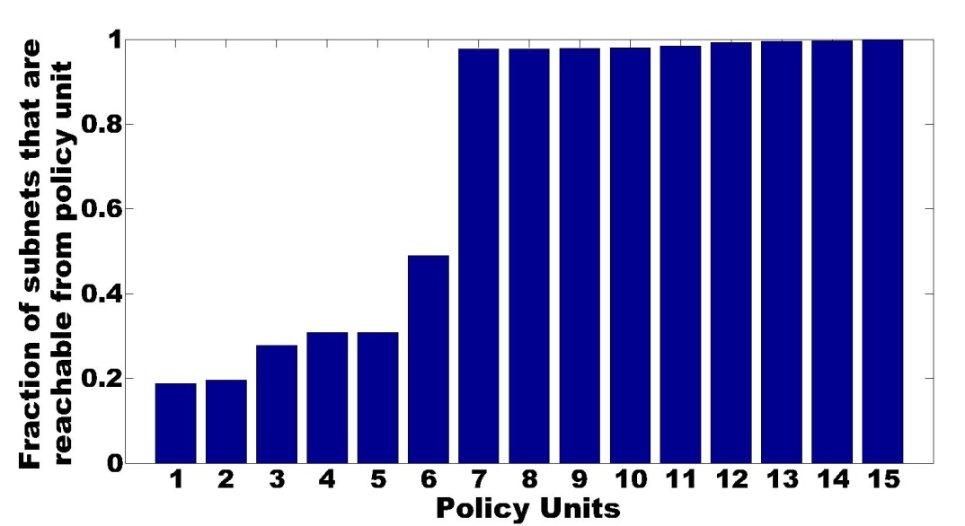
Policy units: Policy-heavy Enterprise
Dichotomy:
  “Default-on”: units 7—15
  “Default-off”: units 1—6
Design separate mechanisms to realize default-off and default-off network parts
  Complexity metrics to design the simplest such network [Ongoing]
Notes:
First half is similar to the previous example
Second half more interesting. Sets of users that can reach less than half of the network.
Able to summarize thousand of lines into 15 units

Slide 42
Conclusion

Slide 43
Deconstructing Network Complexity
Metrics that capture complexity of network configuration
  Predict difficulty of making changes
  Static, layer-3 configuration
  Inform current and future network design
Policy unit extraction
  Useful in management and as invariant in redesign
Empirical study
  Simple policies are often implemented in complex ways
  Complexity introduced by non-technical factors
  Can simplify existing designs

Slide 44
Many open issues…
Comprehensive metrics (other layers)
Simplification framework, config “remapping”
Cross-vendor? Cross-architecture?
ISP networks vs. enterprises
Application design informed by complexity

