Slide 1
Troubleshooting Network Configuration
Nick Feamster
CS 6250: Computer Networking
Fall 2011

Slide 2
Management Research Problems
Organizing diverse data to consider problems across different time scales and across different sites
  Correlations in real time and event-based
  How is data normalized?
Changing the focus: from data to information
  Which information can be used to answer a specific management question?
  Identifying root causes of abnormal behavior (via data mining)
  How can simple counter-based data be synthesized to provide information eg. “something is now abnormal”?
  View must be expanded across layers and data providers

Slide 3
Research Problems (continued)
Automation of various management functions
  Expert annotation of key events will continue to be necessary
Identifying traffic types with minimal information
Design and deployment of measurement infrastructure (both passive and active)
  Privacy, trust, cost limit broad deployment
  Can end-to-end measurements ever be practically supported?
Accurate identification of attacks and intrusions
  Security makes different measurements important

Slide 4
Overcoming Problems
Convince customers that measurement is worth additional cost by targeting their problems
Companies are motivated to make network management more efficient (i.e., reduce headcount)
Portal service (high level information on the network’s traffic) is already available to customers
  This has been done primarily for security services
  Aggregate summaries of passive, netflow-based measures

Slide 5
Long-Term Goals
Programmable measurement
  On network devices and over distributed sites
  Requires authorization and safe execution
Synthesis of information at the point of measurement and central aggregation of minimal information
Refocus from measurement of individual devices to measurement of network-wide protocols and applications
  Coupled with drill down analysis to identify root causes
  This must include all middle-boxes and services

Slide 6
Complex configuration!
Flexibility for realizing goals in
complex business landscape
Which neighboring networks can send traffic
Where traffic enters and leaves the network
How routers within the network learn routes to external destinations
Traffic
Route
No Route
Flexibility
Complexity
Notes:
Primary route selection
Talk about customers and competitors; economic/business landscape
Goal: ensure that customers have reachability to rest of internet, etc.

Slide 7
Why does interdomain routing go awry?
Complex policies
  Competing / cooperating networks
  Each with only limited visibility
Large scale
  Tens of thousands networks
  …each with hundreds of routers
  …each routing to hundreds of thousands of IP prefixes

Slide 8
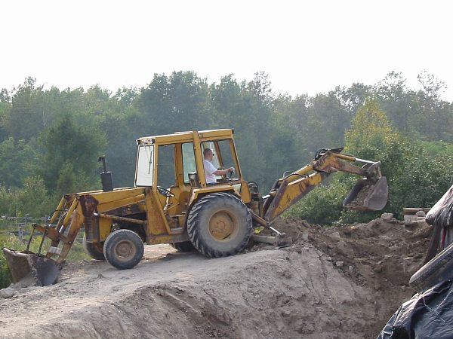
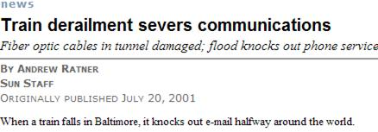
What can go wrong?
Some things are out of the hands of networking research
But…
Two-thirds of the problems are caused by configuration of the routing protocol

Slide 9
Why is routing hard to get right?
Defining correctness is hard
Interactions cause unintended consequences
  Each network independently configured
  Unintended policy interactions
Operators make mistakes
  Configuration is difficult
  Complex policies, distributed configuration
Notes:
Say:
Talk is about the first
upcoming sigcomm paper
Note: mistakes are not the only thing
Prevents two endpoints from *being able* to communicate with each other
Unintended consequence: why is this a real problem in practice?
(maybe a concrete example here…or with the quotes)

Slide 10
What types of problems does configuration cause?
Persistent oscillation (last time)
Forwarding loops
Partitions
“Blackholes”
Route instability
…

Slide 11
Real, Recurrent Problems
“…a glitch at a small ISP… triggered a major outage in Internet access across the country. The problem started when MAI Network Services...passed bad router information from one of its customers onto Sprint.” -- news.com, April 25, 1997
“Microsoft's websites were offline for up to 23 hours...because of a [router] misconfiguration…it took nearly a day to determine what was wrong and undo the changes.” -- wired.com, January 25, 2001
“WorldCom Inc…suffered a widespread outage on its Internet backbone that affected roughly 20 percent of its U.S. customer base. The network problems…affected millions of computer users worldwide. A spokeswoman attributed the outage to "a route table issue."
-- cnn.com, October 3, 2002
"A number of Covad customers went out from 5pm today due to, supposedly, a DDOS (distributed denial of service attack) on a key Level3 data center, which later was described as a route leak (misconfiguration).”
-- dslreports.com, February 23, 2004

Slide 12
January 2006: Route Leak, Take 2
Con Ed 'stealing' Panix routes (alexis) Sun Jan 22 12:38:16 2006
All Panix services are currently unreachable from large portions of the Internet (though not all of it). This is because Con Ed Communications, a competence-challenged ISP in New York, is announcing our routes to the Internet. In English, that means that they are claiming that all our traffic should be passing through them, when of course it should not. Those portions of the net that are "closer" (in network topology terms) to Con Ed will send them our traffic, which makes us unreachable.
“Of course, there are measures one can take against this sort of thing; but it's hard to deploy some of them effectively when the party stealing your routes was in fact once authorized to offer them, and its own peers may be explicitly allowing them in filter lists (which, I think, is the case here). “

Slide 13
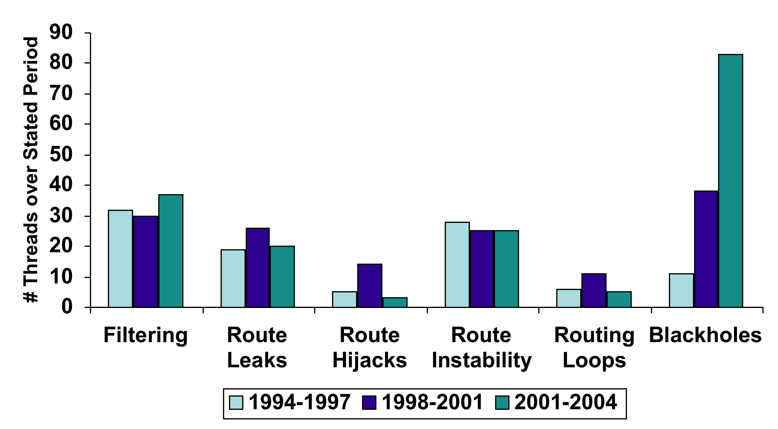
Several “Big” Problems a Week
Notes:
Informal analysis (collected from a mailing list archive): by no means a complete list
Be careful: incidents not decreasing. With larger scale, these incidents could be further reaching.
Statistical analysis just shows that there are a lot of these incidents. Don’t want to make the statement that 1 fire is not important.
Do we need to make the point about ‘fires’?
83 power outages, 1 fire
“Two rats crawled through an underground cable conduit into a cabinet of power switching gear adjacent to the Stanford University cogeneration plant, and caused an explosion that cut off power to the Stanford area.” (October 12, 1996)

Slide 14
How do we guarantee these additional properties in practice?

Slide 15
Today: Reactive Operation
What happens if I tweak this policy…?
Revert
No
Desired
Effect?
Yes
Wait for
Next Problem
Configure
Observe
Problems cause downtime
Problems often not immediately apparent
Notes:
Workflow!! Away from sr towards operation with tool can be used prior to deployment
PICTURE
Problems may be masked
Not just mistakes
What are the kinds of things that people are likely to want to change:
For example: link provision, flash crowd (simple example)

Slide 16
Goal: Proactive Operation
Idea: Analyze configuration before deployment
rcc
Configure
Detect
Faults
Deploy
Many faults can be detected with static analysis.

Slide 17
Correctness Specification
Safety
The protocol converges to a stable path assignment for every possible initial state and message ordering
The protocol does not oscillate
Notes:
Explanation of path visibility wasn’t obvious.
Need to make a simpler explanation of the property
Give some more informal language here: explicitly call out the problems that result when these things are violated. “if you don’t have path visibility, then…”

Slide 18
What about properties of resulting paths, after the protocol has converged?
We need additional correctness properties.

Slide 19
Correctness Specification
Safety
The protocol converges to a stable path assignment for every possible initial state and message ordering
The protocol does not oscillate
Path Visibility
Every destination with a usable path has a route advertisement
If there exists a path,
then there exists a route
Example violation: Network partition
Route Validity
Every route advertisement corresponds to a usable path
If there exists a route,
then there exists a path
Example violation: Routing loop
Notes:
Explanation of path visibility wasn’t obvious.
Need to make a simpler explanation of the property
Give some more informal language here: explicitly call out the problems that result when these things are violated. “if you don’t have path visibility, then…”

Slide 20
Configuration Semantics
Filtering: route advertisement
Ranking: route selection
Customer
Primary
Competitor
Backup
Dissemination: internal route advertisement
Notes:
External filtering vs. internal dissemination
(external vs. internal)
What makes distributed configuration hard?
Filtering: Who gets what
Dissemination: how they get it (the path by which they get it)
Ranking: what they get
Not much else in terms of complicated side effects –
Verifying distributed program’s correctness

Slide 21
Path Visibility: Internal BGP (iBGP)
“iBGP”
Default: “Full mesh” iBGP.
Doesn’t scale.
Large ASes use “Route reflection”
Route reflector:
non-client routes over client sessions;
client routes over all sessions
Client: don’t re-advertise iBGP routes.
Notes:
Put “RR” and “C” in the bubbles to make clear what’s a route reflector
What problem arises?
If the client receives something from a route reflector, it doesn’t re-advertise it

Slide 22
iBGP Signaling: Static Check
Theorem.
Suppose the iBGP reflector-client relationship graph contains no cycles. Then, path visibility is satisfied if, and only if, the set of routers that are not route reflector clients forms a clique.
Condition is easy to check with static analysis.
Notes:
Dina’s question about more complex example.

Slide 23
rcc Overview
Distributed router
configurations
(Single AS)
“rcc”
Correctness
Specification
Constraints
Faults
Normalized
Representation
Challenges
Analyzing complex, distributed configuration
Defining a correctness specification
Mapping specification to constraints
Notes:
Somehow include the theory on this slide. Say “local correctness specification”
Play up the fact that normalized representation is *not easy*!
Interesting engineering sidenote: difficult to parse
Scientific side note: had to come up with a normalized references so that testing constraints is easy
Com,piler guys try to do this for multiple languages (cf)

Slide 24
rcc Implementation
Preprocessor
Parser
Distributed router
configurations
Relational
Database
(mySQL)
(Cisco, Avici, Juniper, Procket, etc.)
Constraints
Verifier
Faults
Notes:
How many lines of code for each one of these modules
Complexity of verifier. (could also talk about this at the beginning)
Advantages of sql: extensible
Talk about the *complexity* of the database and verifier operations
Extensible…
Do it quickly!
Declarative language to run deductive queries

Slide 25
rcc: Take-home lessons
Static configuration analysis uncovers many errors
Major causes of error:
  Distributed configuration
  Intra-AS dissemination is too complex
  Mechanistic expression of policy
Notes:
WORKFLOW
Say something about routing as a distributed program. Approach still likely to be useful.

Slide 26
Two Philosophies
The “rcc approach”: Accept the Internet as is. Devise “band-aids”.
Another direction: Redesign Internet routing to guarantee safety, route validity, and path visibility

Slide 27
Problem 1: Other Protocols
Static analysis for MPLS VPNs
  Logically separate networks running over single physical network: separation is key
  Security policies maybe more well-defined (or perhaps easier to write down) than more traditional ISP policies

Slide 28
Problem 2: Limits of Static Analysis
Problem: Many problems can’t be detected from static configuration analysis of a single AS
Dependencies/Interactions among multiple ASes
  Contract violations
  Route hijacks
  BGP “wedgies” (RFC 4264)
  Filtering
Dependencies on route arrivals
  Simple network configurations can oscillate, but operators can’t tell until the routes actually arrive.

Slide 29
More Problems: BGP Wedgie
AS 1 implements backup link by sending AS 2 a “depref me” community.
AS 2 sets localpref to smaller than that of routes from its upstream provider (AS 3 routes)
AS 3
AS 4
AS 2
“Depref”
Backup
Primary
AS 1

Slide 30
Failure and “Recovery”
AS 3
AS 4
AS 2
“Depref”
Backup
Primary
AS 1
Requires manual intervention

Slide 31

Debugging the Data Plane with Anteater
Haohui Mai, Ahmed Khurshid
Rachit Agarwal, Matthew Caesar
P. Brighten Godfrey, Samuel T. King
University of Illinois at Urbana-Champaign

Slide 32
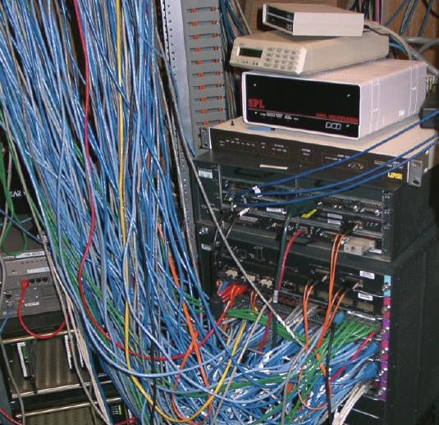
Network debugging is challenging
Production networks are complex
  Security policies
  Traffic engineering
  Legacy devices
  Protocol inter-dependencies
  …
Even well-managed networks can go down
Even SIGCOMM’s network can go down
Few good tools to ensure all networking components working together correctly

Slide 33


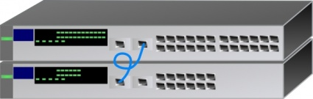
A real example from UIUC network
Previously, an intrusion detection and prevention (IDP) device inspected all traffic to/from dorms
IDP couldn’t handle load; added bypass
  IDP only inspected traffic between dorm and campus
  Seemingly simple changes
dorm
IDP
…
bypass
Backbone

Slide 34

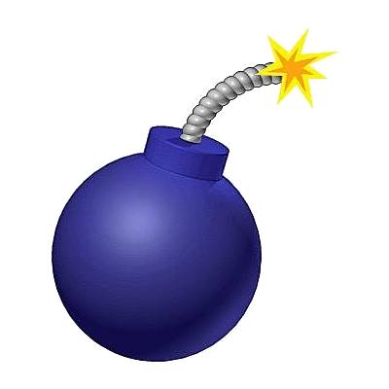
Challenge: Did it work correctly?
Ping and traceroute provide limited testing of exponentially large space
  2³² destination IPs * 2¹⁶ destination ports * …
Bugs not triggered during testing might plague the system in production runs

Slide 35
Previous approach:
Configuration analysis
Configuration
Test before deployment
Prediction is difficult
  Various configuration languages
  Dynamic distributed protocols
Prediction misses implementation bugs in control plane
Input
Control plane
Data plane state
Predicted
Network behavior

Slide 36
Our approach: Debugging the data plane
diagnose problems as close as possible to actual network behavior
Configuration
Less prediction
Data plane is a “narrower waist” than configuration
  Unified analysis for multiple control plane protocols
Can catch implementation bugs in control plane
Checks one snapshot
Control plane
Data plane state
Input
Network behavior
Predicted

Slide 37
Introduction
Design of Anteater
  Data plane as boolean functions
  Express invariants as boolean satisfiability problem (SAT)
  Handling packet transformation
Experiences with UIUC network
Conclusion

Slide 38
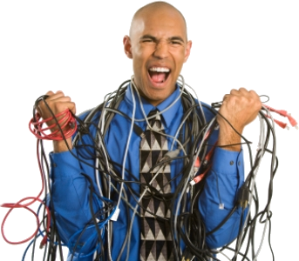

Anteater from 30,000 feet
Operator
Router
Anteater
VPN
Firewalls
Data plane state
SAT formulas
∃Loops?
∃Security policy
violation?
…
Invariants
Diagnosis report
Results of SAT solving
Notes:
Mention data plane states could be collected by automatic scripts running on standard interface.

Slide 39
Challenges for Anteater
Operators shouldn’t have to code SAT manually
  Solution:
  Built-in invariants and scripting APIs
Checking invariants is non-trivial
  Tunneling, MPLS label swapping, OpenFlow, …
  e.g., reachability is NP-Complete with packet filters
  Solution:
  Express data plane and invariants as SAT
  Check with external SAT solver
Notes:
Define reachability

Slide 40
Introduction
Design of Anteater
  Data plane as boolean functions
  Express invariants as boolean satisfiability problem (SAT)
  Handling packet transformation
Experiences with UIUC network
Conclusion

Slide 41
Data plane as boolean functions
Define P(u, v) as the policy function for packets traveling from u to v
  A packet can flow over (u, v) if and only if it satisfies P(u, v)
Destination | Iface
10.1.1.0/24 | v
u
v
P(u, v) = dst_ip ∈10.1.1.0/24

Slide 42
Simpler example
Destination | Iface
0.0.0.0/0 | v
u
v
P(u, v) = true
Default routing

Slide 43
Some more examples
Destination | Iface
10.1.1.0/24 | v
Drop port 80 to v
Destination | Iface
10.1.1.0/24 | v
10.1.1.128/25 | v’
10.1.2.0/24 | v
u
v
u
v
P(u, v) = dst_ip ∈10.1.1.0/24
∧ dst_port ≠ 80
P(u, v) = (dst_ip ∈10.1.1.0/24
∧ dst_ip ∉ 10.1.1.128/25)
∨ dst_ip ∈10.1.2.0/24
Packet filtering
Longest prefix matching

Slide 44
Introduction
Design of Anteater
  Data plane as boolean functions
  Express invariants as boolean satisfiability problem (SAT)
  Handling packet transformation
Experiences with UIUC network
Conclusion

Slide 45
Reachability as SAT solving
Goal: reachability from u to w
  C = (P(u, v) ∧ P(v,w)) is satisfiable
  ∃A packet that makes P(u,v) ∧ P(v,w) true
  ∃A packet that can flow over (u, v) and (v,w)
  u can reach w
u
v
w
  SAT solver determines the satisfiability of C
Problem: exponentially many paths
  Solution: Dynamic programming algorithm

Slide 46
Invariants
Loop-free forwarding: Is there a forwarding loop in the network?
Packet loss. Are there any black holes in the network?
Consistency. Do two replicated routers share the same forwarding behavior including access control policies?
See the paper for details
u
…
w
lost
u
…
w
u
…
w
u’

Slide 47
Introduction
Design of Anteater
  Data plane as boolean functions
  Express invariants as boolean satisfiability problem (SAT)
  Handling packet transformation
Experiences with UIUC network
Conclusion

Slide 48

Packet transformation
Essential to model MPLS, QoS, NAT, etc.
label = 5?
u
v
w
Model the history of packets
Packet transformation ⇒ boolean constraints over adjacent packet versions

Slide 49
Packet transformation (cont.)
Goal: determine reachability from u to w
u
s₀
v
s₁
w
P(u,v)
T(u,v)
P(v,w)
T(u,v) = (s₀.other = s₁.other
∧ s₁.label = )
C_{u-v-w} = P(u,v) (s₀) ∧ T(u,v) ∧ P(v,w) (s₁)
Possible challenge: scalability

Slide 50
Implementation
3,500 lines of C++ and Ruby, 300 lines of awk/sed/python scripts
Collect data plane state via SNMP
Represent boolean functions and constraints as LLVM IR
Translate LLVM IR to SAT formulas
  Use Boolector to resolve SAT queries
  make –j16 to parallelize the checking

Slide 51
Introduction
Design
  Network reachability => boolean satisfiability problem (SAT)
  Handling packet transformation
Experiences with UIUC network
Conclusion

Slide 52
Experiences with UIUC network
Evaluated Anteater with UIUC campus network
  ～178 routers
  Predominantly OSPF, also uses BGP and static routing
  1,627 FIB entries per router (mean)
  Revealed 23 bugs with 3 invariants in 2 hours
 | Loop | Packet loss | Consistency
Being fixed | 9 | 0 | 0
Stale config. | 0 | 13 | 1
False pos. | 0 | 4 | 1
Total alerts | 9 | 17 | 2

Slide 53
Forwarding loops
9 loops between router dorm and bypass
Existed for more than a month
Anteater gives one concrete example of forwarding loop
  Given this example, relatively easy for operators to fix
dorm
bypass
$ anteater
Loop: 128.163.250.30@bypass

Slide 54
Forwarding loops
dorm
Previously, dorm connected to IDP directly
IDP inspected all traffic to/from dorms
IDP
…
Backbone

Slide 55
Forwarding loops
IDP was overloaded, operator introduced bypass
  IDP only inspected traffic for campus
bypass routed campus traffic to IDP through static routes
Introduced loops
dorm
IDP
…
bypass
Backbone

Slide 56

Bugs found by other invariants
Packet loss
Consistency
X
Admin. interface
u
u
u’
192.168.1.0/24
Blocking compromised machines at IP level
Stale configuration
  From Sep, 2008
One router exposed web admin interface in FIB
Different policy on private IP address range
  Maintaining compatibility

Slide 57
Performance:
Practical tool for nightly test
UIUC campus network
  6 minutes for a run of the loop-free forwarding invariant
  7 runs to uncover all bugs for all 3 invariants in 2 hours
Scalability tests on subsets of UIUC campus network
  Roughly quadratic
Packet transformation on UIUC campus network
  Injected NAT transformation at edge routers
  <14 minutes for 20 NAT-enabled routers
Notes:
Runs, conclusions!

Slide 58
Related work
Static reachability analysis in IP network [Xie2005,Bush2003]
Configuration analysis [Al-Shaer2004, Bartal1999, Benson2009, Feamster2005, Yuan2006]

Slide 59
Conclusion
Design and implementation of Anteater: a data plane debugging tool
Demonstrate its effectiveness with finding 23 real bugs in our campus network
Practical approach to check network-wide invariants close to the network’s actual behavior

