Slide 1
The Data Plane
Nick Feamster
CS 6250: Computer Networking
Fall 2011

Slide 2
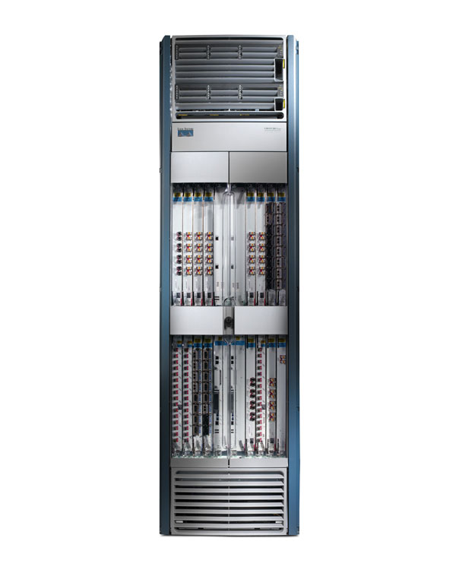
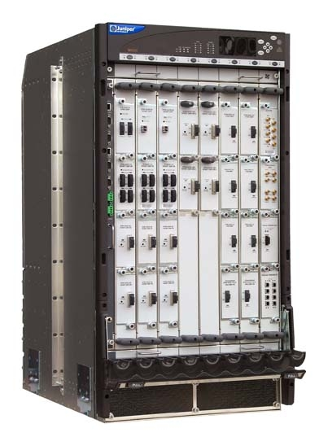
What a Router Chassis Looks Like
Cisco CRS-1
Juniper M320
19”
17”
Capacity: 1.2Tb/s
Power: 10.4kW
Weight: 0.5 Ton
Cost: $500k
Capacity: 320 Gb/s
Power: 3.1kW
6ft
3ft
2ft
2ft

Slide 3
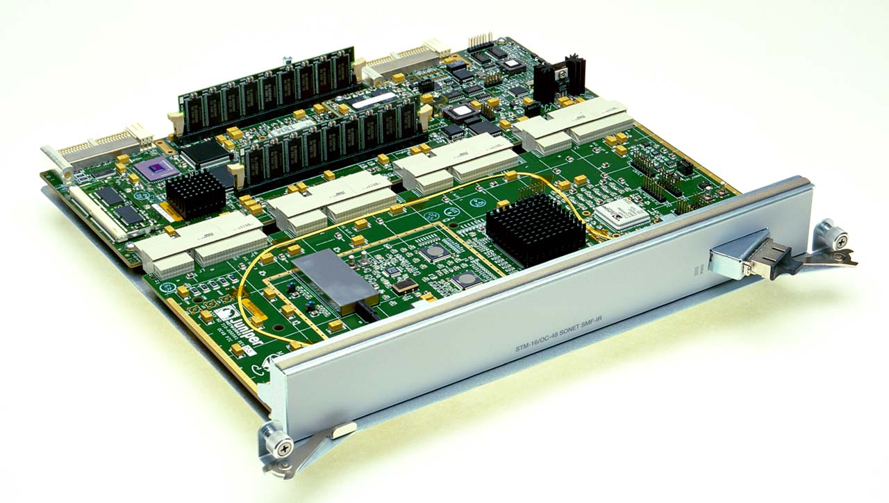
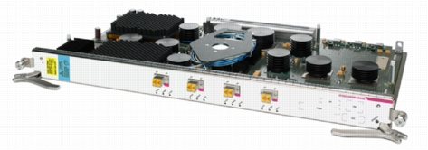
What a Router Line Card Looks Like
1-Port OC48 (2.5 Gb/s)
(for Juniper M40)
4-Port 10 GigE
(for Cisco CRS-1)
10in
2in
Power: about 150 Watts
21in

Slide 4
Big, Fast Routers: Motivation
Faster link bandwidths
Increasing demands
Larger network size (hosts, routers, users)

Slide 5
Generic Router Architecture
Header Processing
Data
Hdr
Lookup
IP Address
Update
Header
Queue
Packet
Data
Hdr
IP Address
Next Hop
Address
Table
Buffer
Memory
1M prefixes
Off-chip DRAM
1M packets
Off-chip DRAM

Slide 6
Life of a Packet at a Router
Router gets packet
Looks at packet header for destination
Looks up forwarding table for output interface
Modifies header (TTL, IP header checksum)
Passes packet to appropriate output interface
Header Processing
Data
Hdr
Lookup
IP Address
Update
Header
Queue
Packet
Data
Hdr
IP Address
Next Hop
Address
Table
Buffer
Memory
1M prefixes
Off-chip DRAM
1M packets
Off-chip DRAM

Slide 7
Data Plane
Streaming algorithms that act on packets
  Matching on some bits, taking a simple action
  … at behest of control and management plane
Wide range of functionality
  Forwarding
  Access control
  Mapping header fields
  Traffic monitoring
  Buffering and marking
  Shaping and scheduling
  Deep packet inspection
Notes:
Question to keep in mind: is there a common way to think about all of these data-plane operations

Slide 8
Packet Forwarding
Control plane computes a forwarding table
  Maps destination address(es) to an output link
Handling an incoming packet
  Match: destination address
  Action: direct the packet to
  the chosen output link
Switching fabric
  Directs packet from
  input link to output link
Processor
Switching
Fabric

Slide 9
Switch: Match on Destination MAC
MAC addresses are location independent
  Assigned by the vendor of the interface card
  Cannot be aggregated across hosts in the LAN
mac1
mac2
mac3
host
host
...
host
mac1
mac2
mac3
mac4
mac5
host
switch
mac5
Implemented using a hash table or a content addressable memory.
host
mac4

Slide 10
IP Routers: Match on IP Prefix
IP addresses grouped into common subnets
  Allocated by ICANN, regional registries, ISPs, and within individual organizations
  Variable-length prefix identified by a mask length
1.2.3.4
1.2.3.7
1.2.3.156
5.6.7.8
5.6.7.9
5.6.7.212
host
host
...
host
host
host
...
host
LAN 1
LAN 2
router
router
router
WAN
WAN
1.2.3.0/24
Prefixes may be nested. Routers identify the longest matching prefix.
5.6.7.0/24
forwarding table

Slide 11
Switch Fabric
Data
1
1
Hdr
Header Processing
Queue
Packet
Lookup
Address
Update
Header
Address
Table
Buffer
Memory
Data
2
2
Hdr
Header Processing
Queue
Packet
Lookup
Address
Update
Header
Address
Table
Buffer
Memory
Data
Hdr
Header Processing
N
N
Queue
Packet
Lookup
Address
Update
Header
Address
Table
Buffer
Memory

Slide 12
Biggest Challenges
Determining the appropriate output port
  IP Prefix Lookup
Scheduling traffic so that each flow’s packets are serviced. Two concerns:
  Efficiency: If there is traffic waiting for an output port, the router should be “busy”
  Fairness: Competing flows should all be serviced

Slide 13
IP Address Lookup: Challenges
  Longest-prefix match
  Tables are large and growing
  Lookups must be fast
  Storage must be memory-efficient

Slide 14
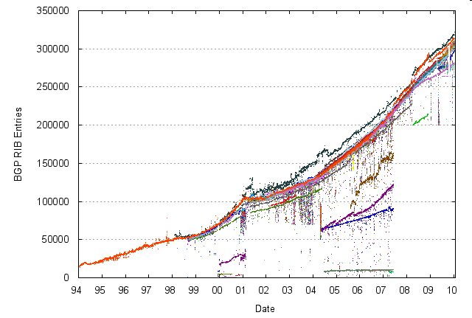
Tables are Large and Growing

Slide 15
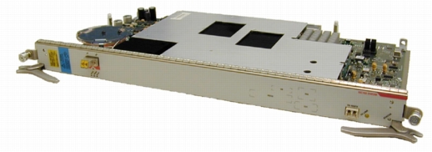
Lookups Must be Fast
Year
Line
40B packets (Mpkt/s)
Cisco CRS-1 1-Port OC-768C
(Line rate: 42.1 Gb/s)
1997
622Mb/s
1.94
OC-12
1999
2.5Gb/s
7.81
OC-48
2001
10Gb/s
31.25
OC-192
2003
40Gb/s
125
OC-768

Slide 16
Lookup

Slide 17
Lookup is Protocol Dependent
Protocol | Mechanism | Techniques
MPLS, ATM, Ethernet | Exact match search | Direct lookup Associative lookup Hashing Binary/Multi-way Search Trie/Tree
IPv4, IPv6 | Longest-prefix match search | Radix trie and variants Compressed trie Binary search on prefix intervals
Notes:
Why is lookup mechanism fundamentally a search? I.e., what are the three of these things:
input key?
Database ?
Output ?

Slide 18
Exact Matches, Ethernet Switches
layer-2 addresses usually 48-bits long
address global, not just local to link
range/size of address not “negotiable”
2⁴⁸ > 10¹², therefore cannot hold all addresses in table and use direct lookup

Slide 19
Exact Matches, Ethernet Switches
advantages:
  simple
  expected lookup time is small
disadvantages
  inefficient use of memory
  non-deterministic lookup time
⇒ attractive for software-based switches, but decreasing use in hardware platforms

Slide 20
IP Lookups find Longest Prefixes
128.9.176.0/24
128.9.16.0/21
128.9.172.0/21
65.0.0.0/8
142.12.0.0/19
128.9.0.0/16
0
128.9.16.14
2³²-1
Routing lookup: Find the longest matching prefix (aka the most specific route) among all prefixes that match the destination address.

Slide 21
IP Address Lookup
routing tables contain (prefix, next hop) pairs
address in packet compared to stored prefixes, starting at left
prefix that matches largest number of address bits is desired match
packet forwarded to specified next hop
routing table
next
hop
prefix
10*
7
01*
5
110*
3
1011*
5
0001*
0
0101 1*
7
0001 0*
1
0011 00*
2
1011 001*
3
1011 010*
5
Problem - large router may have
100,000 prefixes in its list
0100 110*
6
0100 1100*
4
1011 0011*
8
1001 1000*
10
0101 1001*
9
address: 1011 0010 1000

Slide 22
Longest Prefix Match Harder than Exact Match
destination address of arriving packet does not carry information to determine length of longest matching prefix
need to search space of all prefix lengths; as well as space of prefixes of given length

Slide 23
LPM in IPv4: exact match
Use 32 exact match algorithms
Exact match
against prefixes
of length 1
Exact match
against prefixes
of length 2
Network Address
Priority
Encode
and pick
Port
Exact match
against prefixes
of length 32

Slide 24
Address Lookup Using Tries
Trie node
P1 | 111* | H1
P2 | 10* | H2
P3 | 1010* | H3
P4 | 10101 | H4
A
next-hop-ptr (if prefix)
left-ptr
right-ptr
1
B
prefixes “spelled” out by following path from root
to find best prefix, spell out address in tree
last green node marks longest matching prefix
Lookup 10111
adding prefix easy
1
C
0
D
add P5=1110*
P2
1
1
E
F
P1
G
0
0
P3
P5
I
1
H
P4

Slide 25
Single-Bit Tries: Properties
Small memory and update times
  Main problem is the number of memory accesses required: 32 in the worst case
Way beyond our budget of approx 4
  (OC48 requires 160ns lookup, or 4 accesses)

Slide 26
Direct Trie
24 bits
0000……0000
1111……1111
0
2²⁴-1
8 bits
0
2⁸-1
When pipelined, one lookup per memory access
Inefficient use of memory

Slide 27
Multi-bit Tries
Binary trie
W
Depth = W
Degree = 2
Stride = 1 bit
Multi-ary trie
W/k
Depth = W/k
Degree = 2^{k}
Stride = k bits

Slide 28
4-ary Trie (k=2)
A four-ary trie node
A
next-hop-ptr (if prefix)
ptr00
ptr01
ptr10
ptr11
10
11
B
C
P2
Lookup 10111
10
11
10
D
E
F
P3
P1₁
P1₂
P1 | 111* | H1
P2 | 10* | H2
P3 | 1010* | H3
P4 | 10101 | H4
10
11
H
G
P4₁
P4₂

Slide 29
Prefix Expansion with Multi-bit Tries
If stride = k bits, prefix lengths that are not a multiple of k must be expanded
E.g., k = 2:
Prefix | Expanded prefixes
0* | 00*, 01*
11* | 11*

Slide 30
Leaf-Pushed Trie
Trie node
A
left-ptr or next-hop
right-ptr or next-hop
1
B
1
C
0
D
P1 | 111* | H1
P2 | 10* | H2
P3 | 1010* | H3
P4 | 10101 | H4
P2
P1
1
E
P2
G
0
P3
P4

Slide 31
Further Optmizations: Lulea
3-level trie: 16-bits, 8-bits, 8-bits
Bitmap to compress out repeated entries

Slide 32
PATRICIA
Patricia tree internal node
PATRICIA (practical algorithm to retrieve coded information in alphanumeric)
  Eliminate internal nodes with only one descendant
  Encode bit position for determining (right) branching
bit-position
left-ptr
right-ptr
Lookup 10111
A
Bitpos 12345
2
0
1
B
C
P1 | 111* | H1
P2 | 10* | H2
P3 | 1010* | H3
P4 | 10101 | H4
3
P1
0
1
E
P2
5
0
1
F
G
P3
P4

Slide 33
Fast IP Lookup Algorithms
Lulea Algorithm (SIGCOMM 1997)
  Key goal: compactly represent routing table in small memory (hopefully, within cache size), to minimize memory access
  Use a three-level data structure
    Cut the look-up tree at level 16 and level 24
  Clever ways to design compact data structures to represent routing look-up info at each level
Binary Search on Levels (SIGCOMM 1997)
  Represent look-up tree as array of hash tables
  Notion of “marker” to guide binary search
  Prefix expansion to reduce size of array (thus memory accesses)

Slide 34
Faster LPM: Alternatives
Content addressable memory (CAM)
  Hardware-based route lookup
  Input = tag, output = value
  Requires exact match with tag
    Multiple cycles (1 per prefix) with single CAM
    Multiple CAMs (1 per prefix) searched in parallel
  Ternary CAM
    (0,1,don’t care) values in tag match
    Priority (i.e., longest prefix) by order of entries
Historically, this approach has not been very economical.

Slide 35
Switching and Scheduling

Slide 36
Generic Router Architecture
Data
Hdr
Data
Header Processing
Hdr
Buffer
Manager
Lookup
IP Address
Update
Header
Address
Table
Buffer
Memory
Data
Hdr
Data
Header Processing
Hdr
Buffer
Manager
Lookup
IP Address
Update
Header
Interconnection Fabric
Address
Table
Buffer
Memory
Data
Hdr
Data
Hdr
Header Processing
Buffer
Manager
Lookup
IP Address
Update
Header
Address
Table
Buffer
Memory

Slide 37
1st Generation: Switching via Memory
Off-chip Buffer
Shared Bus
CPU
Route
Table
Buffer
Memory
CPU
Line Interface
Memory
Line
Interface
Line
Interface
Line
Interface
MAC
MAC
MAC

Slide 38
Innovation #1: Each Line Card Has the Routing Tables
Prevents central table from becoming a bottleneck at high speeds
Complication: Must update forwarding tables on the fly.
  How would a router update tables without slowing the forwarding engines?

Slide 39
2nd Generation: Switching via Bus
CPU
Route
Table
Buffer
Memory
Line
Card
Line
Card
Line
Card
Buffer
Memory
Buffer
Memory
Buffer
Memory
Fwding
Cache
Fwding
Cache
Fwding
Cache
MAC
MAC
MAC

Slide 40
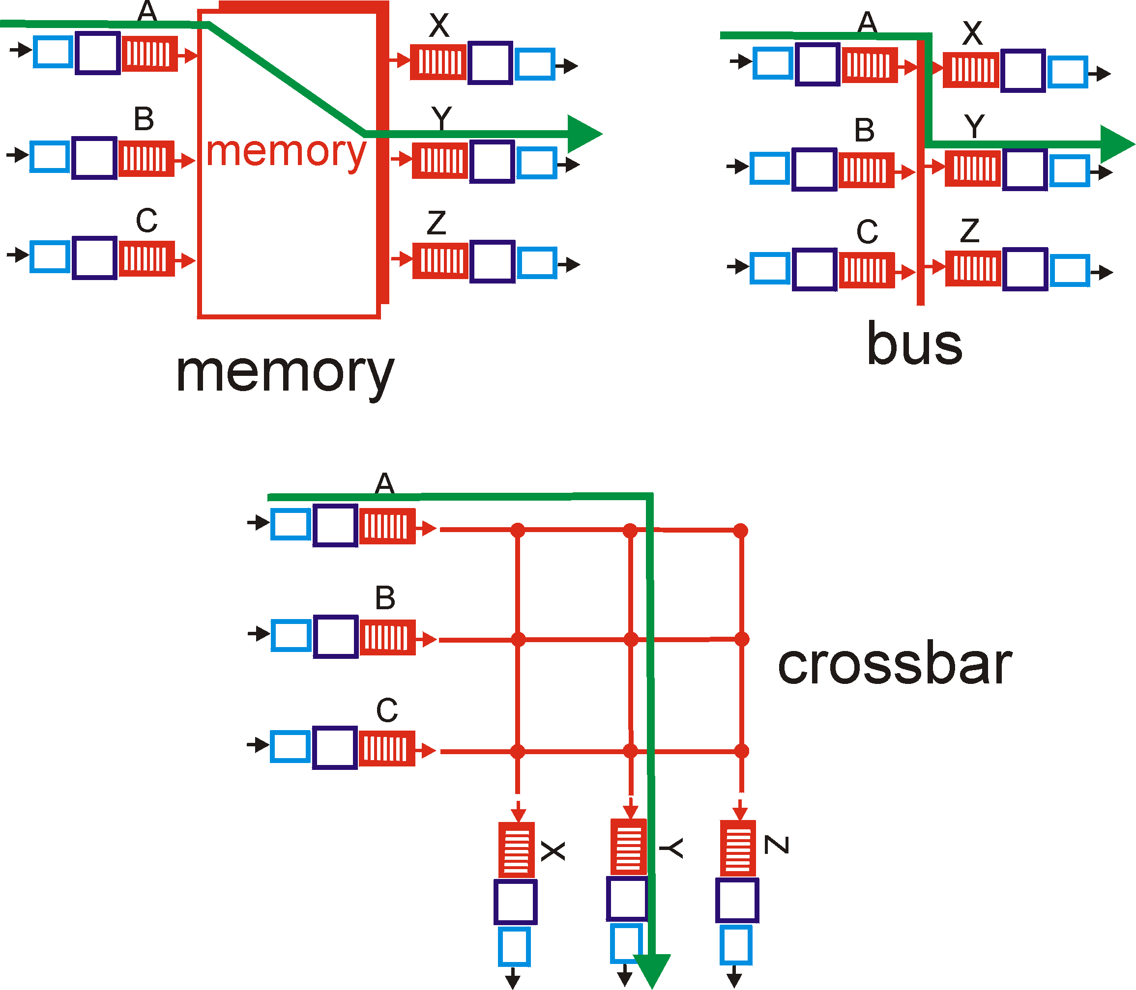
Innovation #2: Switched Backplane
Every input port has a connection to every output port
During each timeslot, each input connected to zero or one outputs
Advantage: Exploits parallelism
Disadvantage: Need scheduling algorithm

Slide 41
Crossbar Switching
Conceptually: N inputs, N outputs
  Actually, inputs are also outputs
In each timeslot, one-to-one mapping between inputs and outputs.
Goal: Maximal matching
Traffic Demands
Bipartite Match
L₁₁(n)
Maximum
Weight Match
L_{N1}(n)

Slide 42
Third Generation Routers
“Crossbar”: Switched Backplane
Line
Card
CPU
Card
Line
Card
Line Interface
Local
Buffer
Memory
Local
Buffer
Memory
CPU
Routing
Table
Memory
Fwding
Table
Fwding
Table
MAC
MAC
Typically <50Gb/s aggregate capacity

Slide 43
Goal: Utilization
“100% Throughput”: no packets experience head-of-line blocking
Does the previous scheme achieve 100% throughput?
What if the crossbar could have a “speedup”?
Key result: Given a crossbar with 2x speedup, any maximal matching can achieve 100% throughput.

Slide 44
Combined Input-Output Queueing
Advantages
  Easy to build
    100% can be achieved with limited speedup
Disadvantages
  Harder to design algorithms
    Two congestion points
    Flow control at destination
Speedup of n: no queueing at input. What about output?
input interfaces
output interfaces
Crossbar

Slide 45
Head-of-Line Blocking
Problem: The packet at the front of the queue experiences contention for the output queue, blocking all packets behind it.
Input 1
Output 1
Input 2
Output 2
Input 3
Output 3
Maximum throughput in such a switch: 2 – sqrt(2)

Slide 46
Solution: Virtual Output Queues
Maintain N virtual queues at each input
  one per output
Input 1
Output 1
Output 2
Input 2
Output 3
Input 3

Slide 47
Scheduling and Fairness
What is an appropriate definition of fairness?
  One notion: Max-min fairness
  Disadvantage: Compromises throughput
Max-min fairness gives priority to low data rates/small values
Is it guaranteed to exist?
Is it unique?

Slide 48
Max-Min Fairness
A flow rate x is max-min fair if any rate x cannot be increased without decreasing some y which is smaller than or equal to x.
How to share equally with different resource demands
  small users will get all they want
  large users will evenly split the rest
More formally, perform this procedure:
  resource allocated to customers in order of increasing demand
  no customer receives more than requested
  customers with unsatisfied demands split the remaining resource

Slide 49
Example
Demands: 2, 2.6, 4, 5; capacity: 10
  10/4 = 2.5
  Problem: 1st user needs only 2; excess of 0.5,
Distribute among 3, so 0.5/3=0.167
  now we have allocs of [2, 2.67, 2.67, 2.67],
  leaving an excess of 0.07 for cust #2
  divide that in two, gets [2, 2.6, 2.7, 2.7]
Maximizes the minimum share to each customer whose demand is not fully serviced

Slide 50
How to Achieve Max-Min Fairness
Take 1: Round-Robin
  Problem: Packets may have different sizes
Take 2: Bit-by-Bit Round Robin
  Problem: Feasibility
Take 3: Fair Queuing
  Service packets according to soonest “finishing time”
Adding QoS: Add weights to the queues…

Slide 51
Router Components and Functions
Route processor
  Routing
  Installing forwarding tables
  Management
Line cards
  Packet processing and classification
  Packet forwarding
Switched bus (“Crossbar”)
  Scheduling

Slide 52
Processing: Fast Path vs. Slow Path
Optimize for common case
  BBN router: 85 instructions for fast-path code
  Fits entirely in L1 cache
Non-common cases handled on slow path
  Route cache misses
  Errors (e.g., ICMP time exceeded)
  IP options
  Fragmented packets
  Mullticast packets

Slide 53
Generalizing the Data Plane

Slide 54
Many Boxes, But Similar Functions
Router
  Forward on destination IP address
  Access control on the “five tuple”
  Link scheduling and marking
  Monitoring traffic
  Deep packet inspection
Switch
  Forward on destination MAC address
Firewall
  Access control on “five tuple” (and more)
NAT
  Mapping addresses and port numbers
Shaper
  Classify packets
  Shape or schedule
Packet sniffer
  Monitoring traffic

Slide 55
OpenFlow
Match
  Match on a subset of bits in the packet header
  E.g., key header fields (addresses, port numbers, etc.)
  Well-suited to capitalize on TCAM hardware
Action
  Perform a simple action on the matching packet
  E.g., forward, flood, drop, rewrite, count, etc.
Controller
  Software that installs rules and reads counts
  ... and handles packets the switch cannot handle

Slide 56
Programmable Data Plane
Programmable data plane
  Arbitrary customized packet-handling functionality
  Building a new data plane, or extending existing one
Speed is important
  Data plane in hardware or in the kernel
  Streaming algorithms the handle packets as they arrive
Two open platforms
  Click: software data plane in user space or the kernel
  NetFPGA: hardware data plane based on FPGAs
Lots of ongoing research activity…

Slide 57
Discussion
Past experiences using Click?
Trade-offs between customizability and performance?
What data-plane model would be “just enough” for most needs, but still fast and inexpensive?
Ways the Internet architecture makes data-plane functionality more challenging?
Middleboxes: an abomination or a necessity?

Slide 58
The Click Modular Router

Slide 59
Introduction
Routers
  Must do much more than route packets
  Designs are too monolithic
  Adding functions difficult
Approach
  Flexible
  Extensible
  Clearly defined interfaces between router functions

Slide 60
Idea: Divide and Conquer
Elements (building blocks)
  Each individual element provides unique function
  Examples
    Packet switching
    Lookup and Classification
    Dropping
Implement functions: assemble building blocks

Slide 61
Aspects of an Element
Class: The code that should be executed when an element processes a packet
Ports: Connections go from output port of one element to input port on another element
Configuration: Additional arguments that are passed to the element at configuration time
Method: Additional functions (e.g., reporting queue length)

Slide 62
Connecting Elements: Push and Pull
Edges between two elements that could be possible data paths for packets
  Push: Upstream element hands over a packet to a downstream element
    packet-arrival element where the data is handed over to the next unit of processing
  Pull: Downstream element requests data from the upstream element
    transmit-side elements where the transmit ports will request for a packet from the previous element

Slide 63
Packet Storage: Queues
Push: elements need to either store packets, discard them, or forward them to the next element.
  Packet storage at element is not implicit.
Queues also implemented as elements so that their insertion/deletion becomes more configurable.
Need to be explicitly put at elements.
Data storage necessary: a push input and a pull output necessitates storage of pushed data until it is requested.

Slide 64
CPU Scheduling
Click schedules the router’s CPU with a task queue
  Router has a loop that processes the task queue one element at a time
Click is single-threaded
  Router continues to process packet through the flow until it is explicitly stored or dropped
  What is the implication of pushing Queues late in the graph?

Slide 65
Push and Pull: Conventions
Push outputs connected to push inputs.
Pull outputs connected to pull inputs.
Agnostic ports (push or pull) can be used as push or pull exclusively.
Routers have same colored inputs and outputs as above.

Slide 66
Data Transfer in Push/Pull
Push-connection: Always initiates data transfer
Pull-connection: Even if pull-input is ready to receive data, a pull-request can return a null-value
  Methods of invoking pull-transfer
    Based on a timer
    Packet upstream notifications: Upstream elements can notify particular downstream elements that they are ready to transmit so that downstream elements can issue requests

Slide 67
Flow-Based Router Context
Packet flow information for an element with respect to the entire router: “Flow-based router context”
  Where a packet is going, or where it came from
Examples
  Upstream elements must find downstream elements interested in packet notification
  Upsteam elements may want to query downstream elements (e.g., RED depends on Queue)

Slide 68
Configuration Language
Two constructs
  Declarations create elements
  Connections say how they are connected
Configuration string passed as is, as a list separated by commas to the element
Other elements used as primitives to define compound elements

Slide 69
Dynamic Reconfiguration
Handlers
  Means of interacting with the elements
  Appear in the user’s /proc file system
  For example, a routing element might have route_add and route_del handlers
Hot Swapping
  Option to “hot swap” in a configuration for certain aspects that are too complex to define as handlers

Slide 70
Example:
IP Router
Classifier determines packet type
Strip Ethernet header
IP checksum, etc.
IP lookup
Decrement TTL
Fragment, etc.

Slide 71
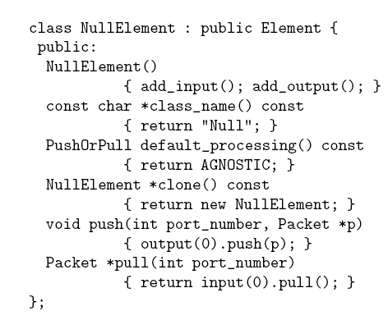
Element Implementation
‘Element’ is the parent class supporting all functionalities as virtual functions
Other classes defined as sub-classes of ‘Element’
NullElement derived from Element
NullElement constructor for initializations
Push and Pull in NullElement override parent functions

Slide 72
Example Extension: Scheduler
Scheduling
A single output queue
Multiple queues
Scheduler
Scheduler as a Multiplexer
Round-Robin scheduling, Priority based scheduling elements have been implemented
Concept of Virtual Queues: Output element does not see the difference between a Queue element and a scheduler.
Complex functionality embedded in queues can be abstracted

Slide 73
Limitations
Decomposition of complex functions into small elements may not always be possible or desirable.
  For example: BGP
Connections reflect packet flow
  Shared elements like routing tables that are not a part of the packet flow is difficult.
(Perhaps) not straightforward to map to underlying hardware.

Slide 74
Click: Summary
Open, extensible, configurable router framework.
The example router configuration proves that a complex router can be designed using simple building blocks.
Performance is acceptable for prototyping.
  Click is still 90% as fast as the base Linux system
Rapid prototyping: Services like scheduling, traffic shaping, rate-limiting encapsulated within elements to give rise to a component-based architecture.

