Slide 1
The Host
Nick Feamster
CS 6250: Computer Networking
Fall 2011

Slide 2
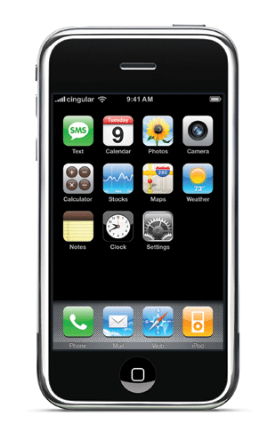

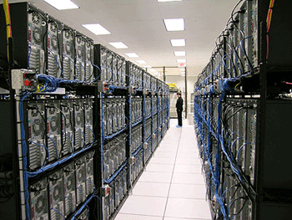
The Host
Becoming increasingly
heterogeneous
  Display sizes
  Power/energy constraints
  Heat dissipation
  Communication media
Supporting an diverse set of
applications
  Conventional: email, Web
  Real-time: voice, video gaming
Impressive evolution of both physical media and applications. What’s the trick?

Slide 3
Three Functions
Discovery: How do hosts find one another?
  DNS: Discovering the IP addresses for names
  ARP: Discovering the MAC addresses for IP addresses
End-to-end Transport: How do hosts communicate with one another?
  TCP: Reliable end-to-end transport
  UDP: Connectionless Transport
Resource Sharing: How do hosts share network resources fairly?

Slide 4
Three Kinds of Identifiers
 | Host Name | IP Address | MAC Address
Example | www.cc.gatech.edu | 130.207.7.210 | 00-15-C5-49-04-A9
Size | Hierarchical, human readable, variable length | Hierarchical, machine readable, 32 bits (in IPv4) | Flat, machine readable, 48 bits
Read by | Humans, hosts | IP routers | Switches in LAN
Allocation, top-level | Domain, assigned by registrar (e.g., for .edu) | Variable-length prefixes, assigned by ICANN, RIR, or ISP | Fixed-sized blocks, assigned by IEEE to vendors (e.g., Dell)
Allocation, low-level | Host name, local administrator | Interface, by admin or DHCP | Interface, by vendor
Notes:
whois –h whois.arin.net 128.112.155.165
http://standards.ieee.org/regauth/oui/oui.txt
Why both MAC and IP:
Need identifier to use in bootstrap process
IP address is topology-dependent, so cannot keep when host moves
- LAN was meant to handle many different network protocols (not just IP)

Slide 5

Learning a Host’s Address
me
you
adapter
adapter
Who am I?
  Hard-wired: MAC address
  Static configuration: IP interface configuration
  Dynamically learned: IP address configured by DHCP
Who are you?
  Hard-wired: IP address in a URL, or in the code
  Dynamically looked up: ARP or DNS

Slide 6
Mapping Between Identifiers
Address Resolution Protocol (ARP)
  Given an IP address, provide the MAC address
  To enable communication within the Local Area Network
Dynamic Host Configuration Protocol (DHCP)
  Given a MAC address, assign a unique IP address
  … and tell host other stuff about the Local Area Network
  To automate the bootstrapping process
Domain Name System (DNS)
  Given a host name, provide the IP address
  Given an IP address, provide the host name

Slide 7
Interconnecting Interfaces on a LAN
LAN/Physical/MAC address
  Unique to physical interface (no two alike)
  Flat structure
datagram
link layer protocol
receiver
sender
frame
frame
adapter
adapter
Frames can be sent to a specific MAC address or to the broadcast MAC address
What are the advantages to separating network layer from MAC layer?

Slide 8
Address Resolution Protocol (ARP)
Every host maintains an ARP table
  (IP address, MAC address) pair
Consult the table when sending a packet
  Map destination IP address to destination MAC address
  Encapsulate and transmit the data packet
But, what if the IP address is not in the table?
  Sender broadcasts: “Who has IP address 1.2.3.156?”
  Receiver responds: “MAC address 58-23-D7-FA-20-B0”
  Sender caches the result in its ARP table

Slide 9
ARP: IP Addresses to MAC addresses
Query is IP address, response is MAC address
Query is sent to LAN’s broadcast MAC address
Each host or router has an ARP table
  Checks IP address of query against its IP address
  Replies with ARP address if there is a match
Potential problems with this approach?
Caching is key!
  Try arp –a to see an ARP table

Slide 10
Dynamic Host Configuration Protocol
DHCP discover
(broadcast)
arriving
client
DHCP offer
DHCP server
Host learns
IP address,
Subnet mask, Gateway address, DNS server(s), and a lease time.
DHCP request
(broadcast)
DHCP ACK

Slide 11
Naming
Problem: How to name an endpoint?
  Host
  Service
  User (?)
Solution: Name machines with human-readable names and map them to IP addresses.
  The Internet infrastructure to resolve this mapping is called the Domain Name System (DNS)

Slide 12
DNS: Mapping Names to Addresses
www.cc.gatech.edu
root, .edu
www.cc.gatech.edu
NS troll-gw.gatech.edu
NS burdell.cc.gatech.edu
troll-gw.gatech.edu
Client
Local
DNS resolver
A 130.207.7.36
Recursive query
burdell.cc.gatech.edu
Iterative queries
Note the diversity of Georgia Tech’s authoritative nameservers

Slide 13
Some Record Types
A
NS
MX
CNAME
TXT
PTR
AAAA
SRV

Slide 14
Caching
Resolvers cache DNS responses
  Quick response for repeated translations
  Other queries may reuse some parts of lookup
    NS records for domains typically cached for longer
  Negative responses also cached
    Typos, “localhost”, etc.
Cached data periodically times out
  Lifetime (TTL) of data controlled by owner of data
  TTL passed with every record
Thought question: What if DNS entries get corrupted?

Slide 15
Root Zone
Generic Top Level Domains (gTLD)
  .com, .net, .org,
Country Code Top Level Domain (ccTLD)
  .us, .ca, .fi, .uk, etc…
Root server ({a-m}.root-servers.net) also used to cover gTLD domains
  Increased load on root servers
  August 2000: .com, .net, .org moved off root servers onto gTLDs

Slide 16
Anycast
Advertise a single IP prefix from multiple distinct locations.
Hosts trying to reach that prefix will (hopefully) go to the closest path
DNS Root: K
DNS Root: K
193.0.14.129
193.0.14.129
AS 2
AS 1
193.0.14.129 AS 2
193.0.14.129 AS 1
AS 3
AS 4
193.0.14.129 AS 3 AS 2
193.0.14.129 AS 1

Slide 17
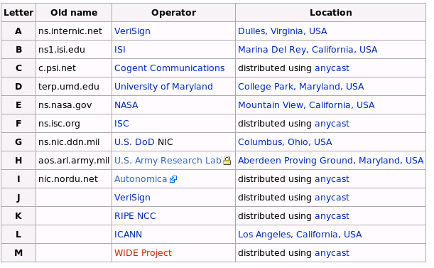
Example Anycasted DNS Root Servers
source: wikipedia

Slide 18
IPv4 Addresses: Networks of Networks
Topological Addressing
32-bit number in “dotted-quad” notation
  www.cc.gatech.edu --- 130.207.7.36
130
207
7
36
10000010
11001111
00000111
00100100
Network (16 bits)
Host (16 bits)
Problem: 2³² addresses is a lot of table entries
Solution: Routing based on network and host
  130.207.0.0/16 is a 16-bit prefix with 2¹⁶ IP addresses

Slide 19
Pre-1994: Classful Addressing
8
16
24
32
Class A
Network ID
0
Host ID
    /8 blocks (e.g., MIT has 18.0.0.0/8)
Class B
10
    /16 blocks (e.g., Georgia Tech has 130.207.0.0/16)
Class C
110
    /24 blocks (e.g., AT&T Labs has 192.20.225.0/24)
Class D
Multicast Addresses
1110
Class E
Reserved for experiments
1111
Simple Forwarding: Address range specifies network ID length

Slide 20
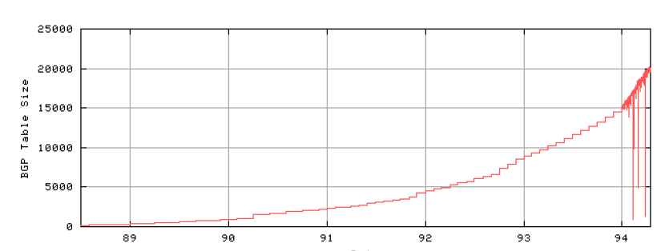
Problem: Routing Table Growth
Source: Geoff Huston
Growth rates exceeding advances in hardware and software capabilities
Primarily due to Class C space exhaustion
Exhaustion of routing table space was on the horizon

Slide 21
Three Solutions
Classless Addressing (CIDR)
Bigger Addresses (IPv6)
Network Address Translation

Slide 22
Classless Interdomain Routing (CIDR)
Use two 32-bit numbers to represent a network.
Network number = IP address + Mask
Example: BellSouth Prefix: 65.14.248.0/22
01000001
00001110
11111000
00000000
11111111
11111111
11111100
00000000
IP Address: 65.14.248.0 “Mask”: 255.255.252.0
Address no longer specifies network ID range.
New forwarding trick: Longest Prefix Match

Slide 23
Benefits of CIDR
Efficiency: Can allocate blocks of prefixes on a finer granularity
Hierarchy: Prefixes can be aggregated into supernets. (Not always done. Typically not, in fact.)
Customer 1
12.20.231.0/24
12.0.0.0/8
AT&T
Internet
Customer 2
12.20.249.0/24

Slide 24
IPv6 and Address Space Scarcity
128-bit addresses
  Top 48-bits: Public Routing Topology (PRT)
    3 bits for aggregation
    13 bits for TLA (like “tier-1 ISPs”)
    8 reserved bits
    24 bits for NLA
  16-bit Site Identifier: aggregation within an AS
  64-bit Interface ID: 48-bit Ethernet + 16 more bits
  Pure provider-based addressing
    Changing ISPs requires renumbering
Question: How else might you make use of these bits?

Slide 25
IPv6: Claimed Benefits
Larger address space
Simplified header
Deeper hierarchy and policies for network architecture flexibility
Support for route aggregation
Easier renumbering and multihoming
Security (e.g., IPv6 Cryptographic Extensions)

Slide 26
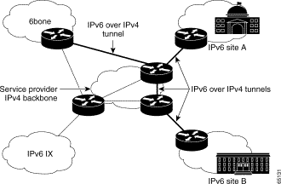
IPv6 over IPv4 Tunnels
One trick for mapping IPv6 addresses: embed the IPv4 address in low bits
http://www.cisco.com/en/US/tech/tk872/technologies_white_paper09186a00800c9907.shtml

Slide 27
End-to-End Transport

Slide 28
Transport Protocols
Provide logical communication between application processes running on different hosts
Run on end hosts
  Sender: breaks application messages into segments,
  and passes to network layer
  Receiver: reassembles segments into messages, passes to application layer
Multiple transport protocols available to applications
  Internet: TCP and UDP
application
transport
network
data link
physical
network
data link
physical
network
data link
physical
network
data link
physical
logical end-end transport
network
data link
physical
network
data link
physical
application
transport
network
data link
physical

Slide 29
Two Basic Transport Features
Demultiplexing: port numbers
Error detection: checksums
Server host 128.2.194.242
Service request for
128.2.194.242:80
(i.e., the Web server)
Client host
Web server
(port 80)
Client
OS
Echo server
(port 7)
IP
payload
detect corruption

Slide 30
User Datagram Protocol (UDP)
Datagram messaging service
  Demultiplexing of messages: port numbers
  Detecting corrupted messages: checksum
Lightweight communication between processes
  Send messages to and receive them from a socket
  Avoid overhead and delays of ordered, reliable delivery
SRC port
DST port
Why does UDP
provide a checksum?
checksum
length
DATA

Slide 31
Advantages to Connectionless Transport
Fine control over what data is sent and when
  As soon as an application process writes into the socket
  … UDP will package the data and send the packet
No delay for connection establishment
  UDP just blasts away without any formal preliminaries
  … which avoids introducing any unnecessary delays
No connection state
  No allocation of buffers, parameters, sequence #s, etc.
  … making it easier to handle many active clients at once
Small packet header overhead
  UDP header is only eight-bytes long

Slide 32
Popular Applications That Use UDP
Multimedia streaming
  Retransmitting lost/corrupted packets is not worthwhile
  By the time the packet is retransmitted, it’s too late
  E.g., telephone calls, video conferencing, gaming
Simple query protocols like Domain Name System
  Overhead of connection establishment is overkill
  Easier to have the application retransmit if needed
“Address for www.cnn.com?”
“12.3.4.15”

Slide 33
Transmission Control Protocol (TCP)
Stream-of-bytes service
  Sends and receives a stream of bytes, not messages
Reliable, in-order delivery
  Checksums to detect corrupted data
  Sequence numbers to detect losses and reorder data
  Acknowledgments & retransmissions for reliable delivery
Connection-oriented
  Explicit set-up and tear-down of TCP session
Flow control
  Prevent overflow of the receiver’s buffer space
Congestion control
  Adapt to network congestion for the greater good

Slide 34
Reasons for Retransmission
Packet
Packet
Packet
Timeout
Timeout
ACK
Timeout
ACK
Packet
Packet
Packet
ACK
Timeout
Timeout
Timeout
ACK
ACK
Packet lost
ACK lost
DUPLICATE
PACKET
Early timeout
DUPLICATE
PACKETS
Notes:
Application may get duplicates in the case of early timeouts

Slide 35
How Long Should Sender Wait?
Sender sets a timeout to wait for an ACK
  Too short: wasted retransmissions
  Too long: excessive delays when packet lost
TCP sets timeout as a function of the RTT
  Expect ACK to arrive after an “round-trip time”
  … plus a fudge factor to account for queuing
But, how does the sender know the RTT?
  Can estimate the RTT by watching the ACKs
  Smooth estimate: keep a running average of the RTT
    EstimatedRTT = a * EstimatedRTT + (1 –a ) * SampleRTT
  Compute timeout: TimeOut = EstimatedRTT + 4 * DevRTT

Slide 36
Round-Trip Time Estimation

Slide 37
A Flaw in This Approach
An ACK doesn’t really acknowledge a transmission
  Rather, it acknowledges receipt of the data
Consider a retransmission of a lost packet
  If you assume the ACK goes with the 1st transmission
  … the Sample RTT comes out way too large
Consider a duplicate packet
  If you assume the ACK goes with the 2nd transmission
  … the Sample RTT comes out way too small
Simple solution in the Karn/Partridge algorithm
  Only collect samples for segments sent one single time

Slide 38
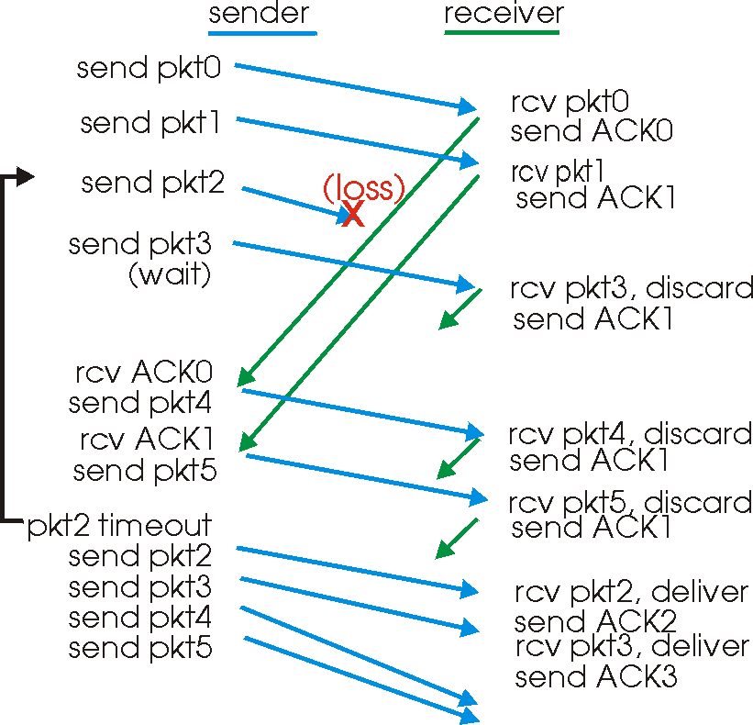
Still, Timeouts are Inefficient
Timeout-based retransmission
  Sender transmits a packet and waits until timer expires and retransmits from the lost packet onward

Slide 39
Fast Retransmission
Better solution possible under sliding window
  Although packet n might have been lost
  … packets n+1, n+2, and so on might get through
Idea: have the receiver send ACK packets
  ACK says that receiver is still awaiting n^{th} packet
    And repeated ACKs suggest later packets have arrived
  Sender can view the “duplicate ACKs” as an early hint
    … that the n^{th} packet must have been lost
    … and perform the retransmission early
Fast retransmission
  Sender retransmits data after the triple duplicate ACK

Slide 40
Flow Control: Sliding Window
Stop-and-wait is inefficient
  Only one TCP segment is “in flight” at a time
  Especially bad when delay-bandwidth product is high
Numerical example
  1.5 Mbps link with a 45 msec round-trip time (RTT)
    Delay-bandwidth product is 67.5 Kbits (or 8 KBytes)
  But, sender can send at most one packet per RTT
    Assuming a segment size of 1 KB (8 Kbits)
    … leads to 8 Kbits/segment / 45 msec/segment ➔ 182 Kbps
    That’s just one-eighth of the 1.5 Mbps link capacity

Slide 41
Sliding Window
Allow a larger amount of data “in flight”
  Allow sender to get ahead of the receiver
  … though not too far ahead
Sending process
Receiving process
TCP
TCP
Last byte written
Last byte read
Next byte expected
Last byte ACKed
Last byte received
Last byte sent

Slide 42
Resource Sharing

Slide 43
The Problem of Congestion
What is congestion?
  Load is higher than capacity
What do IP routers do?
  Drop the excess packets
Why is this bad?
  Wasted bandwidth for retransmissions
Goodput
“congestion
collapse”
Increase in load that results in a decrease in useful work done.
Load

Slide 44
Congestion
10 Mbps
1.5 Mbps
100 Mbps
Different sources compete for resources inside network
Why is it a problem?
  Sources are unaware of current state of resource
  Sources are unaware of each other
Manifestations:
  Lost packets (buffer overflow at routers)
  Long delays (queuing in router buffers)
  Can result in throughput less than bottleneck link (1.5Mbps for the above topology) → a.k.a. congestion collapse

Slide 45
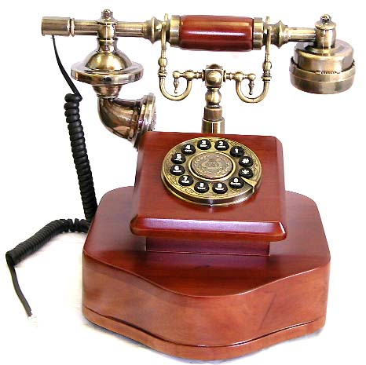
No Problem with Circuit Switching
Source establishes connection to destination
  Nodes reserve resources for the connection
  Circuit rejected if the resources aren’t available
  Cannot have more than the network can handle

Slide 46
Congestion is Unavoidable
Two packets arrive at the same time
  The node can only transmit one
  … and either buffer or drop the other
If many packets arrive in short period of time
  The node cannot keep up with the arriving traffic
  … and the buffer may eventually overflow

Slide 47
The Problem of Congestion
What is congestion?
  Load is higher than capacity
What do IP routers do?
  Drop the excess packets
Why is this bad?
  Wasted bandwidth for retransmissions
Goodput
“congestion
collapse”
Increase in load that results in a decrease in useful work done.
Load

Slide 48
Congestion Collapse
Definition: Increase in network load results in decrease of useful work done
Many possible causes
  Spurious retransmissions of packets still in flight
    Classical congestion collapse
    How can this happen with packet conservation? RTT increases!
    Solution: better timers and TCP congestion control
  Undelivered packets
    Packets consume resources and are dropped elsewhere in network
    Solution: congestion control for ALL traffic

Slide 49
End Hosts Adjusting to Congestion
End hosts adapt their sending rates
  In response to network conditions
Learning that the network is congested
  Shared Ethernet: carrier sense multiple access
    Seeing your own frame collide with others
  IP network: observing your end-to-end performance
    Packet delay or loss over the end-to-end path
Adapting to congestion
  Slowing down the sending rate, for the greater good
  But, host doesn’t know how bad things might be…

Slide 50
Congestion Control and Avoidance
A mechanism that:
  Uses network resources efficiently
  Preserves fair network resource allocation
  Prevents or avoids collapse
Congestion collapse is not just a theory
  Has been frequently observed in many networks

Slide 51
Congestion Control Approaches
Two approaches
End-end congestion control:
  No explicit feedback from network
  Congestion inferred from end-system observed loss, delay
  Approach taken by TCP
Network-assisted congestion control:
Routers provide feedback to end systems
Single bit indicating congestion (SNA, DECbit, TCP/IP ECN, ATM)
Explicit rate sender should send at
Problem: makes routers complicated

Slide 52
How it Looks to the End Host
Packet delay
  Packet experiences high delay
Packet loss
  Packet gets dropped along the way
How does TCP sender learn this?
  Delay
    Round-trip time estimate
  Loss
    Timeout
    Duplicate acknowledgments

Slide 53
TCP Congestion Window
Each TCP sender maintains a congestion window
  Maximum number of bytes to have in transit
  I.e., number of bytes still awaiting acknowledgments
Adapting the congestion window
  Decrease upon losing a packet: backing off
  Increase upon success: optimistically exploring
  Always struggling to find the right transfer rate
Both good and bad
  Pro: avoids having explicit feedback from network
  Con: under-shooting and over-shooting the rate

Slide 54
Additive Increase, Multiplicative Decrease
How much to increase and decrease?
  Increase linearly, decrease multiplicatively
  A necessary condition for stability of TCP
  Consequences of over-sized window are much worse than having an under-sized window
    Over-sized window: packets dropped and retransmitted
    Under-sized window: somewhat lower throughput
Multiplicative decrease
  On loss of packet, divide congestion window in half
Additive increase
  On success for last window of data, increase linearly

Slide 55
Leads to the TCP “Sawtooth”
Window
Loss
halved
t

Slide 56
Slow Start and the TCP Sawtooth
Window
Loss
Exponential “slow start”
t
Why is it called slow-start? Because TCP originally had
no congestion control mechanism. The source would just
start by sending a whole receiver window’s worth of data.

Slide 57
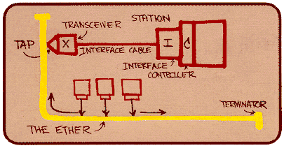
Ethernet Back-off Mechanism
Carrier sense: wait for link to be idle
  If idle, start sending; if not, wait until idle
Collision detection: listen while transmitting
  If collision: abort transmission, and send jam signal
Exponential back-off: wait before retransmitting
  Wait random time, exponentially larger on each retry

Slide 58
Questions
What role should the network play in resource allocation?
  Explicit feedback to the end hosts?
  Enforcing an explicit rate allocation?
What is a good definition of fairness?
What about hosts who cheat to hog resources?
  How to detect cheating? How to prevent/punish?
What about wireless networks?
  Difficulty of detecting collisions (due to fading)
  Loss caused by interference, not just congestion

Slide 59
“A Protocol for Packet Network Intercommunication”
(IEEE Trans. on Communications, May 1974)
Vint Cerf and Bob Kahn
Written when Vint Cerf was an assistant professor at Stanford, and Bob Kahn was working at ARPA.

Slide 60
Life in the 1970s…
Multiple unconnected networks
  ARPAnet, data-over-cable, packet satellite (Aloha), packet radio, …
Heterogeneous designs
  Addressing, max packet size, handling of lost/corrupted data, fault detection, routing, …
ARPAnet
satellite net

Slide 61
Handling Heterogeneity
Where to handle heterogeneity?
  Application process? End hosts? Packet switches?
Compatible process and host conventions
  Obviate the need to support all combinations
Retain the unique features of each network
  Avoid changing the local network components
Introduce the notion of a gateway

Slide 62
Internetwork Layer and Gateways
Internetwork Layer
Gateway
Internetwork appears as a single, uniform entity
Despite the heterogeneity of the local networks
Network of networks
“Embed internetwork packets in local packet format or extract them”
Route (at internetwork level) to next gateway
gateway
ARPAnet
satellite net

Slide 63
Internetwork Packet Format
internetwork header
local
header
source
address
dest.
address
seq.
#
byte
count
flag
field
text
checksum
Internetwork header in standard format
  Interpreted by the gateways and end hosts
Source and destination addresses
  Uniformly and uniquely identify every host
Ensure proper sequencing of the data
  Include a sequence number and byte count
Enable detection of corrupted text
  Checksum for an end-to-end check on the text

Slide 64
Process-Level Communication
Enable pairs of processes to communicate
  Full duplex
  Unbounded but finite-length messages
  E.g., keystrokes or a file
Key ideas
  Port numbers to (de)multiplex packets
  Breaking messages into segments
  Sequence numbers and reassembly
  Retransmission and duplicate detection
  Window-based flow control

Slide 65
Discussion
What did they get right?
  Which ideas were key to the Internet’s success?
  Which decisions still seem right today?
What did they miss?
  Which ideas had to be added later?
  Which decisions seem wrong in hindsight?
What would you do in a clean-slate design?
  If your goal wasn’t to support communication between disparate packet-switched networks
  Would you do anything differently?

Slide 66
“End-to-End Arguments in System Design”
(ACM Trans. on Computer Systems, November 1984)
J. Saltzer, D. Reed, and D. Clark

Slide 67
End-to-End Argument
Operations should occur only at the end points
… unless needed for performance optimization
2
4
3
1
5
Many things can go wrong: disk errors, software errors, hardware errors, communication errors, …

Slide 68
Trade-Offs
Put functionality at each hop
  All applications pay the price
  End systems still need to check for errors
Place functionality only at the ends
  Slower error detection
  End-to-end retransmission wastes bandwidth
Compromise solution?
  Reliable end-to-end transport protocol (TCP)
  Plus file checksums to detect file-system errors

Slide 69
Discussion
When should the network support a function anyway?
  E.g., link-layer retransmission in wireless networks?
Who’s interests are served by the e2e argument?
How does a network operator influence the network without violating the e2e argument?
Does the design of IP and TCP make it *hard* to violate the e2e argument?
  E.g., middlebox functionality like NATs, firewalls, proxies
Should the e2e argument apply to routing?

