Slide 1
Network Security: Spam
Nick Feamster
Georgia Tech
CS 6250
Joint work with Anirudh Ramachanrdan, Shuang Hao, Santosh Vempala, Alex Gray

Slide 2

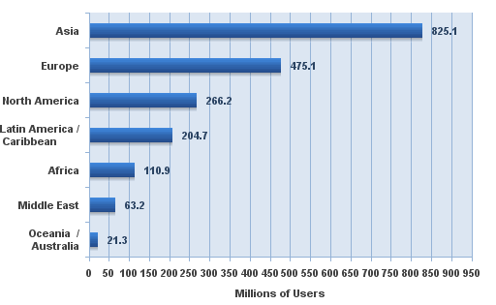
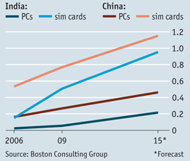
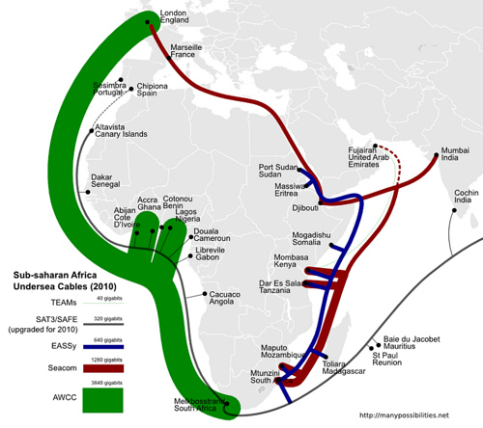

Internet Penetration is
Increasing
More people
  Today: 1.9B users
  2020: 5B users
More global
  Africa, India: ~7% penetration
More traffic
  44 exabytes by 2012
Source: internet world stats
As the Internet continues to reach more people, the stakes for controlling access to information will increase.
Notes:
Transit prices in Kenya have dropped to $120/Mbps – about what they were in the US in about 2003

Slide 3
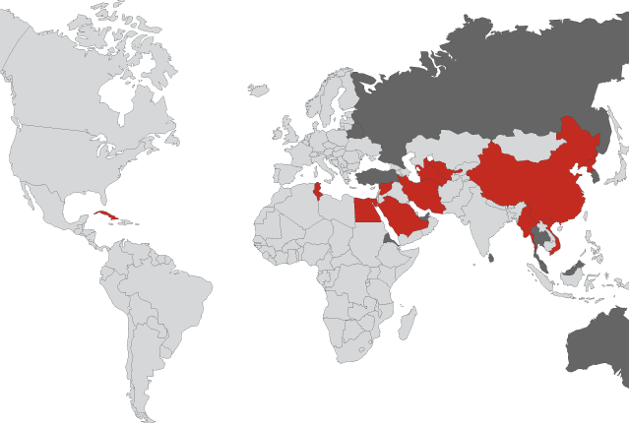
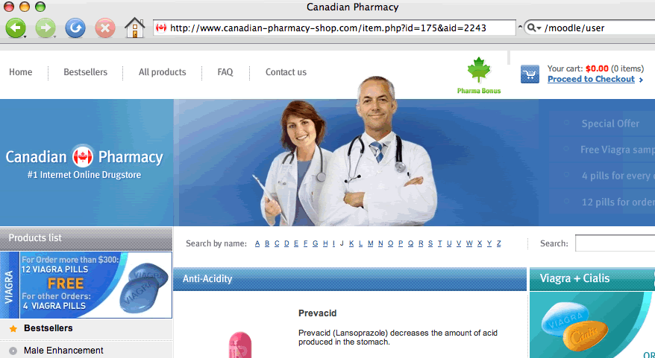
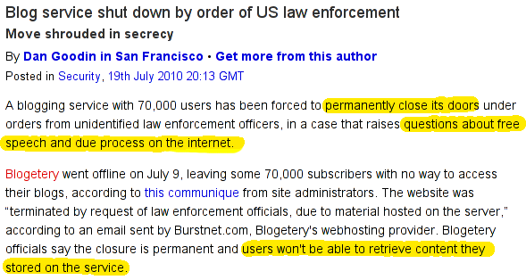
The Battle for Control
Reducing unwanted traffic: As much as 95% of email traffic is spam
  Spam moving to new domains such as Twitter
  About 50k new phishing attacks every month
Facilitating free and open communication: Nearly 60 countries censor Internet content

Slide 4
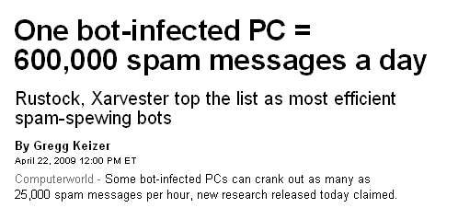
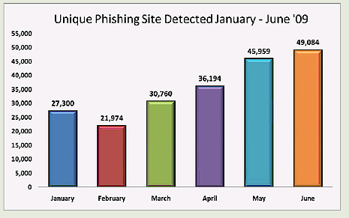
Spam: More than Just a Nuisance
95% of all email traffic
  Image and PDF Spam
  (PDF spam ~12%)
As of August 2007, one
in every 87 emails was a phishing attack
Targeted attacks on rise
  ~50,000 unique phishing
  attacks per month
Source: APWG

Slide 5

Approach: Filter
Prevent unwanted traffic from reaching a user’s inbox by distinguishing spam from ham
Question: What features best differentiate spam from legitimate mail?
  Content-based filtering: What is in the mail?
  IP address of sender: Who is the sender?
  Behavioral features: How the mail is sent?

Slide 6

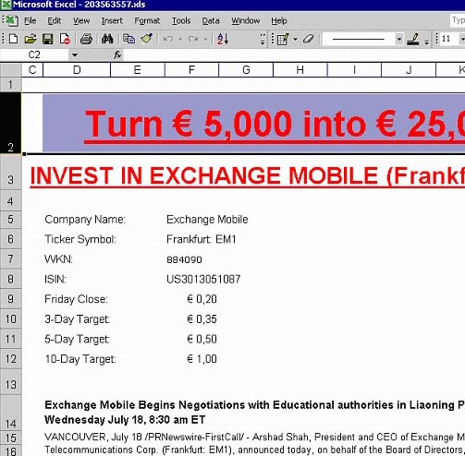

Approach #1: Content Filters
PDFs
Excel sheets
Images
...even mp3s!

Slide 7
Problems with Content Filtering
Customized emails are easy to generate: Content-based filters need fuzzy hashes over content, etc.
Low cost to evasion: Spammers can easily alter features of an email’s content can be easily adjusted and changed
High cost to filter maintainers: Filters must be continually updated as content-changing techniques become more sophisticated

Slide 8
Approach #2: IP Addresses
Received: from mail-ew0-f217.google.com (mail-ew0-f217.google.com [209.85.219.217])
by mail.gtnoise.net (Postfix) with ESMTP id 2A6EBC94A1
for <feamster@gtnoise.net>; Fri, 21 Oct 2011 10:08:24 -0400 (EDT)
Problem: IP addresses are ephemeral
Every day, 10% of senders are from previously unseen IP addresses
Possible causes
  Dynamic addressing
  New infections

Slide 9
Main Idea: Network-Based Filtering
Filter email based on how it is sent, in addition to simply what is sent.
Network-level properties: lightweight, less malleable
  Network/geographic location of sender and receiver
  Set of target recipients
  Hosting or upstream ISP (AS number)
  Membership in a botnet (spammer, hosting infrastructure)

Slide 10
Challenges
Understanding network-level behavior
  What network-level behaviors do spammers have?
  How well do existing techniques (e.g., DNS-based blacklists) work?
Building classifiers using network-level features
  Key challenge: Which features to use?
  Two Algorithms: SNARE and SpamTracker
Anirudh Ramachandran and Nick Feamster, “Understanding the Network-Level Behavior of Spammers”, ACM SIGCOMM, 2006
Anirudh Ramachandran, Nick Feamster, and Santosh Vempala, “Filtering Spam with Behavioral Blacklisting”, ACM CCS, 2007
Shuang Hao, Nick Feamster, Alex Gray and Sven Krasser, “SNARE: Spatio-temporal Network-level Automatic Reputation Engine”, USENIX Security, August 2009

Slide 11
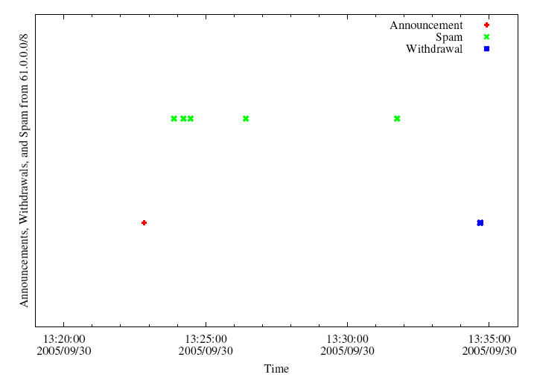
Surprising: BGP “Spectrum Agility”
Hijack IP address space using BGP
Send spam
Withdraw IP address
A small club of persistent players appears to be using this technique.
Common short-lived prefixes and ASes
~ 10 minutes
61.0.0.0/8 4678
66.0.0.0/8 21562
82.0.0.0/8 8717
Somewhere between 1-10% of all spam (some clearly intentional, others “flapping”)

Slide 12
Other Findings
Top senders: Korea, China, Japan
  Still about 40% of spam coming from U.S.
More than half of sender IP addresses appear less than twice
~90% of spam sent to traps from Windows

Slide 13
Challenges
Understanding network-level behavior
  What network-level behaviors do spammers have?
  How well do existing techniques (e.g., DNS-based blacklists) work?
Building classifiers using network-level features
  Key challenge: Which features to use?
  Two Algorithms: SNARE and SpamTracker
Anirudh Ramachandran and Nick Feamster, “Understanding the Network-Level Behavior of Spammers”, ACM SIGCOMM, 2006
Anirudh Ramachandran, Nick Feamster, and Santosh Vempala, “Filtering Spam with Behavioral Blacklisting”, ACM CCS, 2007
Shuang Hao, Nick Feamster, Alex Gray and Sven Krasser, “SNARE: Spatio-temporal Network-level Automatic Reputation Engine”, USENIX Security, August 2009

Slide 14
Finding the Right Features
Goal: Sender reputation from a single packet?
  Low overhead
  Fast classification
  In-network
  Perhaps more evasion-resistant
Key challenge
  What features satisfy these properties and can distinguish spammers from legitimate senders?

Slide 15
Set of Network-Level Features
Single-Packet
  Geodesic distance
  Distance to k nearest senders
  Time of day
  AS of sender’s IP
  Status of email service ports
Single-Message
  Number of recipients
  Length of message
Aggregate (Multiple Message/Recipient)

Slide 16
Sender-Receiver Geodesic Distance
90% of legitimate messages travel 2,200 miles or less

Slide 17
Density of Senders in IP Space
For spammers, k nearest senders are much closer in IP space
Notes:
XXX Fix This XXX

Slide 18
Local Time of Day at Sender
Spammers “peak” at different local times of day

Slide 19
Combining Features: RuleFit
Put features into the RuleFit classifier
10-fold cross validation on one day of query logs from a large spam filtering appliance provider
Comparable performance to SpamHaus
  Incorporating into the system can further reduce FPs
Using only network-level features
Completely automated

Slide 20
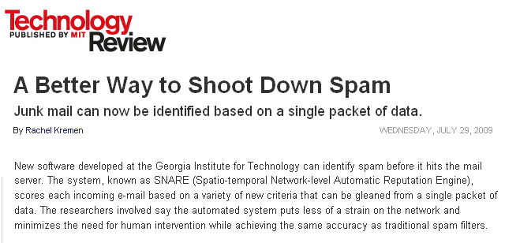
SNARE: Putting it Together
Email arrival
Whitelisting
Greylisting
Retraining

