Slide 1
Internet Economics
CS6250 - Fall 2011
Vytautas Valancius

Slide 2
Agenda
When Life Was Simple: Phone Networks
Network of Networks: The Internet
  Connectivity structure
Pricing in the Internet: One-Size-Fits-All
  Consumer demand
  Network costs
  Pricing

Slide 3
Economics of Phone Networks
1876 – the first “long-distance” call
1926 – the first transatlantic call
Example of communication in today’s phone network
  Before an information exchange, the call is setup
  The calling party attains value
  Pays for the call
  The payment propagates
Can this work in the Internet?
Value: $$$
Phone
Network A
Phone
Network B
You
$$
$
Your Buddy
Customer-Provider
Peer-Peer
Provider-Customer

Slide 4

Who Should Pay in the Internet?
Example:
  You connect to Netflix
  Netflix sends you a movie
Who should pay?
  You
  Netflix
  Both
  None
Response
(10GB)
Network B
Network A
You
Request
(1KB)
In practice both pay.
How much each party should pay?

Slide 5
Structure of the Internet
Network of networks
  Smaller networks have to pay large networks to reach other remote networks
  Smaller networks can peer to avoid large networks
  Large networks have to peer or pay each other
Who should pay?
Level3
Cogent
Money flow up.
$
$
$
GaTech
CNN
IBM
?

Slide 6
Cost-Based Peering
Some large networks use cost-based peering
  “Let’s peer if the cost you incur in your network are similar to the cost I incur in my network.”
  Cost ~ Bits X Miles
    Two flows: 10 bits and 5 bits
    ISP1: 10bits x 2 miles + 5 bits X 4 miles = 40 bitmiles
    ISP2: 10bits x 1 mile + 5bits X 6 miles = 40 bitmiles
    Costs are “equal”.
ISP1
ISP2
2mi
Flow1
1mi
4mi
Flow2
6mi

Slide 7
How Are ISPs Pricing Connectivity?
Single price in $/Mbps/month
Charged each month on aggregate throughput
  Some flows are costly
  Some are cheaper to serve
  Price is set to recover total costs + margin
Convenient for ISPs and clients
EU
Cost: $$$
Cogent
US
Cost: $
Blended rate
Price: $$
GaTech
Can be inefficient!

Slide 8
Issues With Blended Rate Pricing
Uniform price yet diverse resource costs
Clients
ISPs
Lack of incentives to conserve
resources to costly destinations
Lack of incentives to invest
in resources to costly destinations
Pareto inefficient resource allocation
  A well studied concept in economics
Potential loss to ISP profit and client surplus
Alternative: tiered pricing
Notes:
ISPs signal costs through congestion. It might be desirable to signal cost through prices, instead of dropping packets.

Slide 9
Tiered Pricing
Price flows based on cost and demand
Some ISPs already use tiered pricing
  Regional pricing
  Paid peering
  Backplane peering
  Limited number of tiers
Regional pricing example:
Global, Cost: $$$
Cogent
Local
Cost: $
Price:
$$$
Price:
$
U Toronto
Question:
How efficient is such tiered pricing?
Can ISPs benefit from more tiers?
Notes:
Other services, such as postal service and airlines, have many pricing tiers – for some reason the current Internet has only 1 or few pricing tiers. Why?

Slide 10
Challenges
How can we test the effects of
tiered pricing on ISP profits?
Construct an ISP profit model that accounts for:
  Demand to destinations
  Servicing costs of destinations
Drive the model with real data
  Demand functions from real traffic data
  Servicing costs from real topology data
Test the effects of tiered pricing!
Modeling
Data
mapping
Number
crunching

Slide 11
ISP Profit Model: Assumptions
Profit = Revenue – Costs
(for all flows)
Flow revenue
  Price * Traffic Demand
  Traffic Demand is a function of price
  How do we model and discover demand functions?
Flow cost
  Servicing Cost * Traffic Demand
  Servicing Cost is a function of distance
  How do we model and discover servicing costs?
Notes:
Servicing cost – cost to service one bit of traffic. It is possible to extend the model to account 95th percentile, or to consider: cost = servicing cost * log(traffic demand).
See equation (1) for generic profit formula.

Slide 12
Approach to Modeling
1. Finding Demand Functions
2. Modeling Costs
Traffic Demands
Current Prices
Network Topologies
Demand Models
Cost Models
Demand Functions
Relative costs
3. Reconciling cost with demand
Profit Model
Absolute costs

Slide 13
Finding Demand Functions
Canonical destination demand function:
Inelastic demand
Price
Demand = F(Price, Valuation, Elasticity)
Elastic demand
Valuation – how valuable flow is
Elasticity – how fast demand changes with price
Demand
How to find the demand function parameters?
Valuation = F⁻¹(Price, Demand, Elasticity)
Current price
Assumed range of elasticities
Current flow
demand
We mapped traffic data to
demand functions!
Notes:
See equations (2) and (7) for CED and Logit demand functions.

Slide 14
Approach to Modeling
1. Finding Demand Functions
2. Modeling Costs
Traffic Demands
Current Prices
Network Topologies
Demand Models
Cost Models
Demand Functions
Relative costs
Profit Model
Absolute costs

Slide 15






Modeling Costs
How can we model flow costs?
$$c_{i}$$
$$c_{i}$$
Linear:
Concave:
$$d_{i}$$
$$d_{i}$$
$$c_{i}$$
$$c_{i}$$
Region:
Dest. type:
$$d_{i}$$
$$d_{i}$$
ISP topologies and peering information alone
can only provide us with relative flow servicing costs.
real_costs = γ * relative_costs

Slide 16
Approach to Modeling
1. Finding Demand Functions
2. Modeling Costs
Traffic Demands
Current Prices
Network Topologies
Demand Models
Cost Models
Demand Functions
Relative costs
3. Reconciling cost with demand
Profit Model
Absolute costs

Slide 17
Normalizing Costs and Demands
Assuming ISP is rational and profit maximizing:
Profit = Revenue – Costs = F(price, valuations, elasticities, real_costs)
F’(price*, valuations, elasticities, real_costs) = 0
F’ (price*, valuations, elasticities, γ * relative_costs) = 0
γ = F^{’-1(}price*, valuations, elasticities, relative_costs)
Data mapping is complete: we know demands and costs!
Subject to the noise that is inherent in any structural estimation.
Notes:
See section 4.1.3 for more details.

Slide 18
Testing ISP Pricing Strategies
Select a number of pricing tiers to test
  1, 2, 3, etc.
Map flows into pricing tiers
  Optimal mapping and mapping heuristics
Find profit maximizing price for each pricing tier and compute the profit
Repeat above for:
2x demand models
4x cost models
3x network topologies and traffic matrices

Slide 19
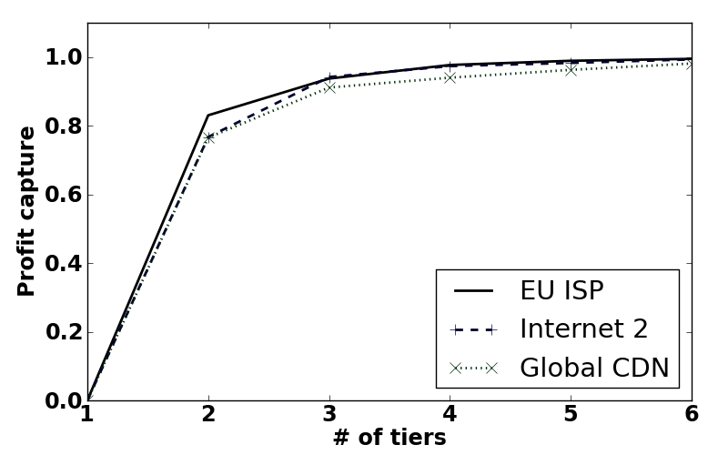
Results: Profit Capture
Constant elasticity demand with linear cost model
Tier 1: Local traffic
Tier 2: The rest of the traffic
*Elasticity – 1.1, base cost – 20%, seed price - $20

Slide 20
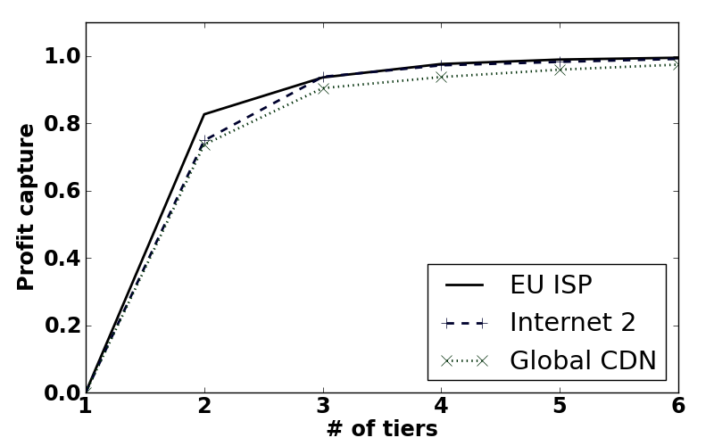
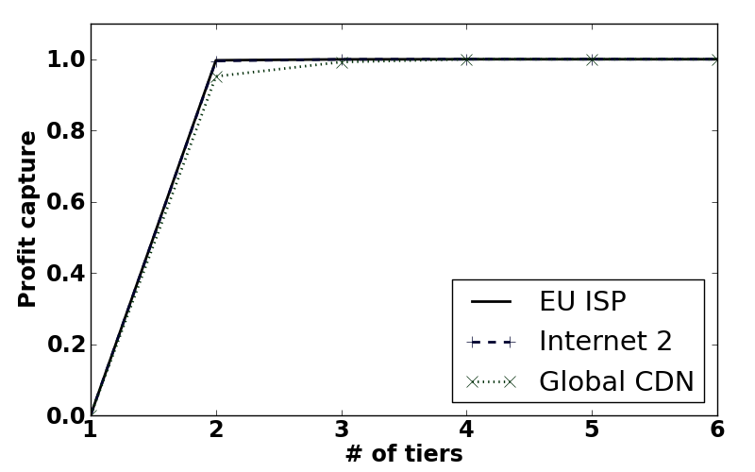
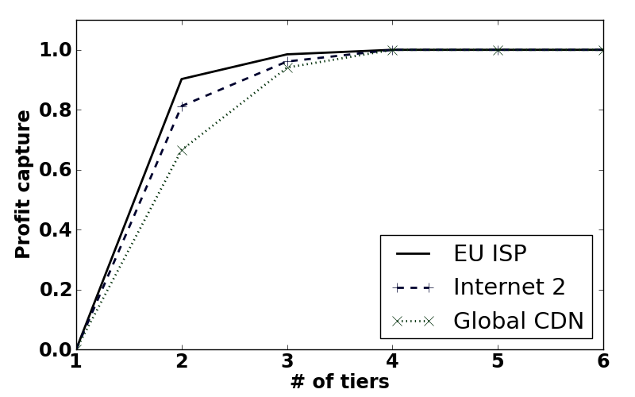
Results: Big Picture
Linear Cost Model
Concave Cost Model
Constant
Elasticity
Demand
Logit
Demand

Slide 21
Conclusion
Having more than 2-3 pricing tiers adds only marginal benefit to the ISP
Profit capture is dependent on cost and demand variance
The results hold for wide range of scenarios
  Different demand and cost models
  Different network topologies and demands
  Large range of input parameters
Current transit pricing strategies are close to optimal!
Questions?

Slide 23
What About Competition?
Very hard to model!
Perhaps requires game-theoretic approach and more data (such as where the topologies overlap, etc.)
It is possible to model some effects of competition by treating demand functions as representing residual instead of inherent demand. See Perloff’s “Microeconomics” pages 243-246 for discussion about residual demand.

Slide 24
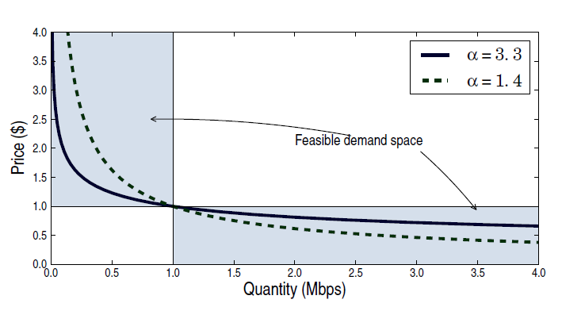

Slide 25
What About Costs of Implementing Tiered Pricing?
Past 4-5 tiers the costs are marginal in practice (Section 5.)
Higher costs with more tiers reinforce our findings: more tiers will add even less benefit to ISP.

Slide 26
How can ISPs use this?
ISPs can perfect these models to estimate how much different flows add to their cost structure.
ISPs can use the pricing methods we developed.
ISPs can verify if, given their topology and demand, they might benefit form more tiers.

