Slide 1
Transit Traffic Engineering
Nick Feamster CS 6250: Computer Networks Fall 2011

Slide 2
Do IP Networks Manage Themselves?
In some sense, yes:
TCP senders send less traffic during congestion
Routing protocols adapt to topology changes
But, does the network run efficiently?
Congested link when idle paths exist?
High-delay path when a low-delay path exists?
How should routing adapt to the traffic?
Avoiding congested links in the network
Satisfying application requirements (e.g., delay)
… essential questions of traffic engineering

Slide 3
Outline
ARPAnet routing protocols
Three protocols, with complexity/stability trade-offs
Tuning routing-protocol configuration
Tuning link weights in shortest-path routing
Tuning BGP policies on edge routers
MPLS traffic engineering
Explicit signaling of paths with sufficient resources
Constrained shortest-path first routing
Multipath load balancing
Preconfigure multiple (disjoint) paths
Dynamics adjust splitting of traffic over the path

Slide 4
ARPAnet Routing

Slide 5
Original ARPAnet Routing (1969)
Routing
Shortest-path routing based on link metrics
Distance-vector algorithm (i.e., Bellman-Ford)
Metrics
Instantaneous queue length plus a constant
Each node updates distance computation periodically
2
3
1
1
3
2
1
5
20
congested link

Slide 6
Problems With the Algorithm
Instantaneous queue length
Poor indicator of expected delay
Fluctuates widely, even at low traffic levels
Leading to routing oscillations
Distance-vector routing
Transient loops during (slow) convergence
Triggered by link weight changes, not just failures
Protocol overhead
Frequent dissemination of link metric changes
Leading to high overhead in larger topologies

Slide 7
New ARPAnet Routing (1979)
Averaging of the link metric over time
Old: Instantaneous delay fluctuates a lot
New: Averaging reduces the fluctuations
Link-state protocol
Old: Distance-vector path computation leads to loops
New: Link-state protocol where each router computes shortest paths based on the complete topology
Reduce frequency of updates
Old: Sending updates on each change is too much
New: Send updates if change passes a threshold

Slide 8
Performance of New Algorithm
Light load
Delay dominated by the constant part (transmission delay and propagation delay)
Medium load
Queuing delay is no longer negligible on all links
Moderate traffic shifts to avoid congestion
Heavy load
Very high metrics on congested links
Busy links look bad to all of the routers
All routers avoid the busy links
Routers may send packets on longer paths

Slide 9
Over-Reacting to Congestion
I-85
ATL
Sandy Springs
GA400
“Backup at I-85” on radio triggers congestion on GA400
Routers make decisions based on old information
Propagation delay in flooding link metrics
Thresholds applied to limit number of updates
Old information leads to bad decisions
All routers avoid the congested links
… leading to congestion on other links
… and the whole things repeats

Slide 10
Problem of Long Alternate Paths
Picking alternate paths
Multi-hop paths look better than a congested link
Long path chosen by one router consumes resource that other packets could have used
Leads other routers to pick other alternate paths
2
3
1
1
3
2
1
5
20
congested link

Slide 11
Revised ARPAnet Metric (1987)
Limit path length
Bound the value of the link metric
“This link is busy enough to go two extra hops”
Prevent over-reacting
Shed traffic from a congested link gradually
Starting with alternate paths that are just slightly longer
Through weighted average in computing the metric, and limits on the change from one period to the next
New algorithm
New way of computing the link weights
No change to link-state routing or shortest-path algorithm

Slide 12
Tuning Routing-Protocol Configuration

Slide 13
Routing With “Static” Link Weights
Routers flood information to learn topology
Determine “next hop” to reach other routers…
Compute shortest paths based on link weights
Link weights configured by network operator
2
3
1
1
3
2
1
5
4
3

Slide 14
Setting the Link Weights
How to set the weights
Inversely proportional to link capacity?
Proportional to propagation delay?
Network-wide optimization based on traffic?
2
3
1
1
3
2
3
1
5
4
3

Slide 15
Measure, Model, and Control
Network-wide
“what if” model
Topology/
Configuration
Offered
traffic
Changes to
the network
measure
control
Operational network

Slide 16
Key Ingredients
Measurement
Topology: monitoring of the routing protocols
Traffic matrix: passive traffic measurement
Network-wide models
Representations of topology and traffic
“What-if” models of shortest-path routing
Network optimization
Efficient algorithms to find good configurations
Operational experience to identify constraints

Slide 17
Optimization Problem
Input: graph G(R,L)
R is the set of routers
L is the set of unidirectional links
c_{l} is the capacity of link l
Input: traffic matrix
M_{i,j} is traffic load from router i to j
Output: setting of the link weights
w_{l} is weight on unidirectional link l
P_{i,j,l} is fraction of traffic from i to j traversing link l

Slide 18
Equal-Cost Multipath (ECMP)
0.25
0.25
0.5
1.0
1.0
0.25
0.25
0.5
0.5
0.5
Values of P_{i,j,l}

Slide 19
Objective Function
Computing the link utilization
Link load: u_{l} = Σ_{i,j} M_{i,j} P_{i,j,l}
Utilization: u_{l}/c_{l}
Objective functions
min(max_{l}(u_{l}/c_{l}))
min(Σ_{l} f(u_{l}/c_{l}))
f(x)
x

Slide 20
Complexity of Optimization Problem
NP-complete optimization problem
No efficient algorithm to find the link weights
Even for simple objective functions
What are the implications?
Have to resort to searching through weight settings
Clearly suboptimal, but effective in practice
Fast computation of the link weights
Good performance, compared to “optimal” solution

Slide 21
Incorporating Operational Realities
Minimize number of changes to the network
Changing just 1 or 2 link weights is often enough
Tolerate failure of network equipment
Weights settings usually remain good after failure
… or can be fixed by changing one or two weights
Limit dependence on measurement accuracy
Good weights remain good, despite random noise
Limit frequency of changes to the weights
Joint optimization for day & night traffic matrices

Slide 22
Apply to Interdomain Routing
Limitations of intradomain traffic engineering
Alleviating congestion on edge links
Making use of new or upgraded edge links
Influencing choice of end-to-end path
Extra flexibility by changing BGP policies
Direct traffic toward/from certain edge links
Change the set of egress links for a destination
2
1
4
3

Slide 23
BGP Model for Traffic Engineering
Predict effects of changes to import policies
Inputs: routing, traffic, and configuration data
Outputs: flow of traffic through the network
BGP policy
configuration
Topology
BGP routing
model
BGP
routes
Offered
traffic
Flow of traffic through the network

Slide 24
Reasons for Interdomain TE
Congested Edge Link
Links between domains are common points of congestion in the Internet
Upgraded Link Capacity
Operators frequently install higher-bandwidth links
Aim to exploit the additional capacity
Violation of Peering Agreement

Slide 25
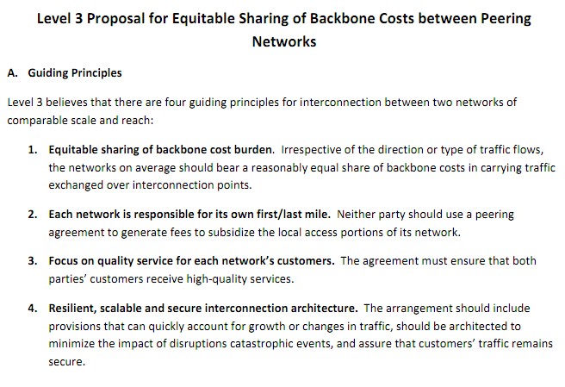
Example Peering Guidelines

Slide 26
Goals for Interdomain TE
Predictable traffic flow changes
Limiting the influence of neighboring domains
Check for consistent advertisements
Use BGP policies that limit the influence of neighbors
Reduce the overhead of routing changes
Focus on small number of prefixes

Slide 27
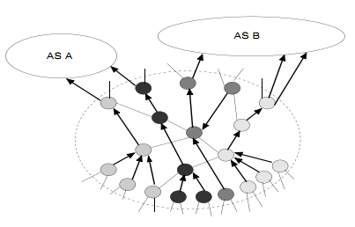
Tools for Interdomain TE
Essentially, adjusting local preference to affect egress point selection
Prediction
Set of egress points per prefix
Figure out the path from each router to egress

Slide 28
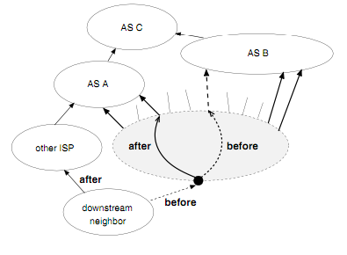
Predictable Traffic Flow Changes
Avoid globally visible changes
Don’t do things that would result in changes to routing decisions from a neighboring AS
For example, make adjustments for prefixes that are only advertised via one neighbor AS

Slide 29
Limit the Influence of Neighbors
Limit the influence of AS path length
Consider treating paths that have “almost the same length” as a common group
Try to enforce consistent advertisements from neighbors (note: difficult problem!)

Slide 30
Reduce the Overhead of Changes
Group related prefixes
Don’t explore all combinations of prefixes
Simplify configuration changes
Routing choices: groups routes that have the same AS paths (lots of different granularities to choose from)
Focus on the (small) fraction of prefixes that carry the majority of the traffic
E.g., top 10% of origin ASes are responsible for about 82% of outbound traffic

Slide 31
MPLS Traffic Engineering

Slide 32
Limitations of Shortest-Path Routing
Sub-optimal traffic engineering
Restricted to paths expressible as link weights
Limited use of multiple paths
Only equal-cost multi-path, with even splitting
Disruptions when changing the link weights
Transient packet loss and delay, and out-of-order
Slow adaptation to congestion
Network-wide re-optimization and configuration
Overhead of the management system
Collecting measurements and performing optimization

Slide 33
Explicit End-to-End Paths
Establish end-to-end path in advance
Learn the topology (as in link-state routing)
End host or router computes and signals a path
Routers supports virtual circuits
Signaling: install entry for each circuit at each hop
Forwarding: look up the circuit id in the table
1: 7
2: 7
link 7
1: 14
2: 8
1
link 14
2
link 8
Used in MPLS with RSVP

Slide 34
Label Swapping
Problem: using VC ID along the whole path
Each virtual circuit consumes a unique ID
Starts to use up all of the ID space in the network
Label swapping
Map the VC ID to a new value at each hop
Table has old ID, next link, and new ID
Allows reuse of the IDs at different links
1: 7: 20
2: 7: 53
20: 14: 78
53: 8: 42
link 7
1
link 14
2
link 8

Slide 35
Multi-Protocol Label Switching
Multi-Protocol
Encapsulate a data packet
Could be IP, or some other protocol (e.g., IPX)
Put an MPLS header in front of the packet
Actually, can even build a stack of labels…
Label Switching
MPLS header includes a label
Label switching between MPLS-capable routers
MPLS header
IP packet

Slide 36
Pushing, Popping, and Swapping
Pushing: add the initial “in” label
Swapping: map “in” label to “out” label
Popping: remove the “out” label
Pushing
Swapping
Popping
IP
IP
IP
IP
C
A
R2
IP edge
R1
R4
B
R3
D
MPLS core

Slide 37
Constrained Shortest Path First
Run a link-state routing protocol
Configurable link weights
Plus other metrics like available bandwidth
Constrained shortest-path computation
Prune unwanted links (e.g., not enough bandwidth)
Compute shortest path on the remaining graph
Signal along the path
Source router sends a message to pin the path to destination
Revisit decisions periodically, in case better options exist
s
5, bw=10
d
3, bw=80
5, bw=70
6, bw=60

Slide 38
Multipath Load Balancing

Slide 39
Multiple Paths
Establish multiple paths in advance
To make good use of the bandwidth
To survive link and router failures

Slide 40
Measure Link Congestion
Disseminate link-congestion information
Flood throughout the network
Piggyback on data packets
Direct through a central controller

Slide 41
Adjust Traffic Splitting
Source router adjusts the traffic
Changing traffic rate or fraction on each path
… based on the level of congestion
35%
65%

Slide 42
Challenges
Protocol dynamics
Stability: avoid over-reacting to congestion
Convergence time: avoid under-reacting to congestion
Analysis using control or optimization theory!
Protocol overhead
State for maintaining enough (failure-disjoint) paths
Bandwidth overhead of disseminating link metrics
Computation overhead of recomputing traffic splits
Implementing non-equal traffic splitting
Hash-based splitting to prevent packet reordering
Applying the approach in an interdomain setting

Slide 43
Conclusion: Main Issues
How are the paths expressed?
Shortest-path routing with (changing) link weights
End-to-end path (or paths) through the network
Timescale of routing decisions?
Packet, flow, larger aggregates, longer timescale, …
Role of path diversity?
Single-path routing where the one path can be changed
Multi-path routing where splitting over paths can change
Who adapts the routes?
Routers: through adaptive routing protocols
Management system: through central (re)optimization

