Slide 1
White-Space Networking
Nick Feamster
CS 6250
Fall 2011
(slides from Rohan Murty)

Slide 2
Motivation
Bandwidth becoming scarcer and more valuable
  Increased demands on wireless applications
  Users demand higher performance
Dynamically accessing multiple channels can increase spectrum efficiency
Our goal is to support multiple transmissions and increase performance by mitigating interference

Slide 3
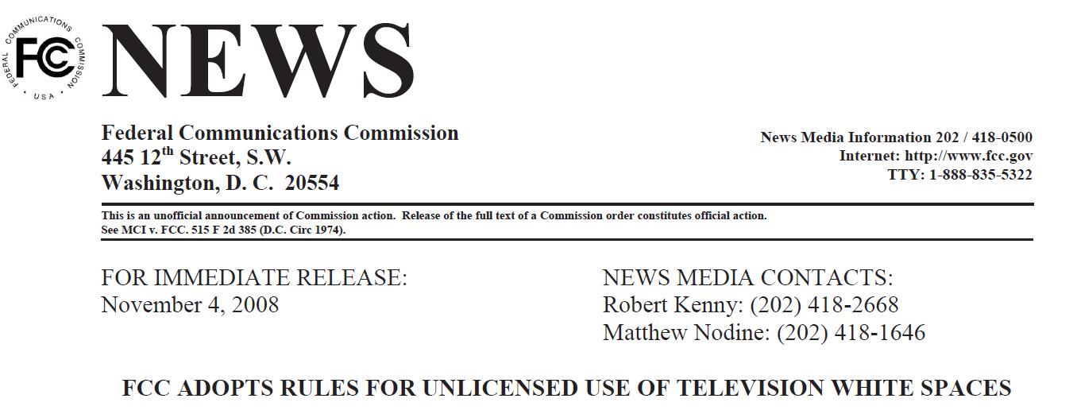
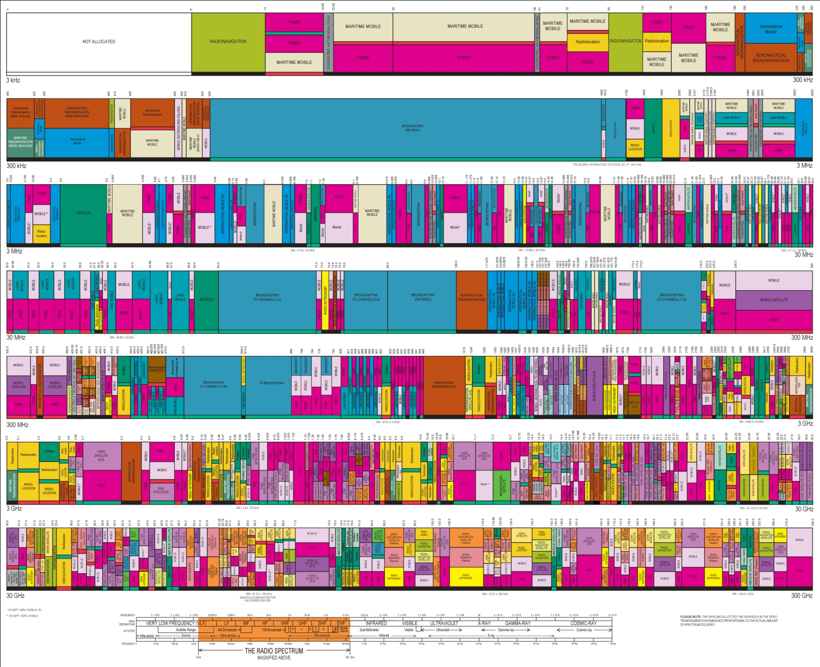



Higher Frequency
Broadcast TV
Wi-Fi (ISM)

Slide 4


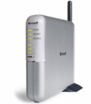
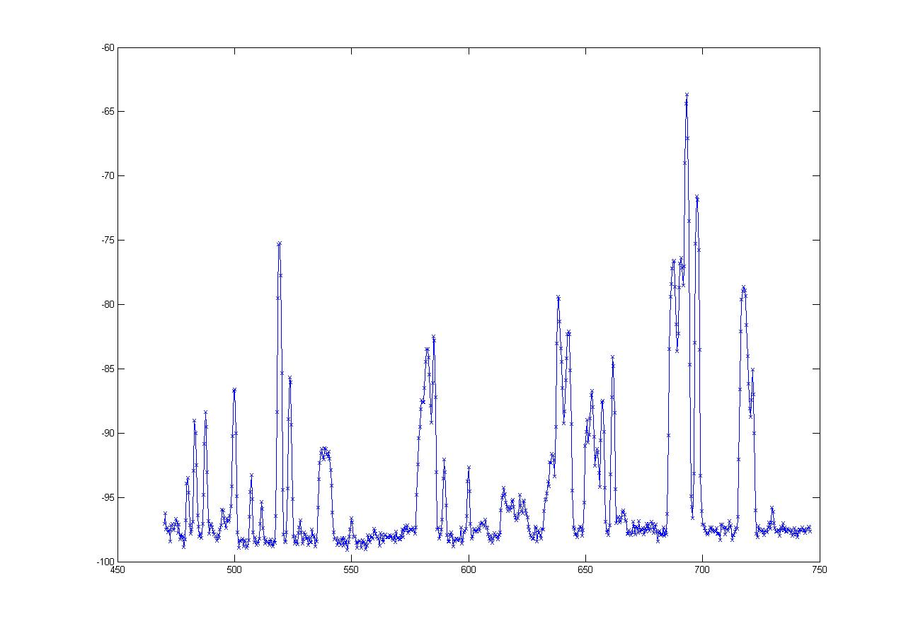
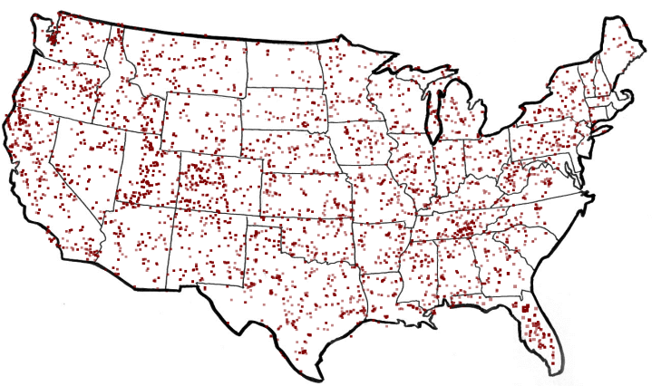
What are White Spaces?
TV
Wireless Mic
ISM (Wi-Fi)
0
MHz
54-90
170-216
470
700
2400
2500
5180
5300
7000
MHz
  50 TV Channels
  Each channel is 6 MHz wide
-60
“White spaces”
dbm
FCC Regulations*
    Sense TV stations and Mics
    Portable devices on channels 21 - 51
TV Stations in America
-100
470 MHz
Frequency
700 MHz
are Unoccupied TV Channels
White Spaces

Slide 5
The Promise of White Spaces
TV
Wireless Mic
ISM (Wi-Fi)
0
MHz
470
700
2400
2500
5180
5300
54-90
174-216
7000
MHz
More Spectrum
Up to 3x of 802.11g
Longer Range
at least 3 - 4x of Wi-Fi

Slide 6

White Spaces Spectrum Availability
Differences from ISM(Wi-Fi)
Fragmentation
Variable channel widths
1
2
3
4
5
1
2
3
4
5
Each TV Channel is 6 MHz wide
Spectrum is Fragmented
⇒ Use multiple channels for more bandwidth

Slide 7
White Spaces Spectrum Availability
Differences from ISM(Wi-Fi)
Fragmentation
Variable channel widths
Spatial Variation
Cannot assume same
channel free everywhere
1
2
3
4
5
1
2
3
4
5
TV
Tower
Location impacts spectrum availability
⇒ Spectrum exhibits spatial variation

Slide 8


White Spaces Spectrum Availability
Differences from ISM(Wi-Fi)
Fragmentation
Variable channel widths
Spatial Variation
Cannot assume same
channel free everywhere
1
2
3
4
5
Temporal Variation
1
2
3
4
5
Same Channel will
not always be free
Any connection can be
disrupted any time
Incumbents appear/disappear over time
⇒ Must reconfigure after disconnection

Slide 9

Channel Assignment in Wi-Fi
1
6
11
1
6
11
Fixed Width Channels
⇒ Optimize which channel to use

Slide 10
Spectrum Assignment in WhiteFi
Spectrum Assignment Problem
Goal
Maximize Throughput
Include
Spectrum at clients
1
2
3
4
5
1
2
3
4
5
Center Channel
Assign
&
Width
Fragmentation
⇒ Optimize for both, center channel and width
Spatial Variation
⇒ BS must use channel iff free at client

Slide 11
Accounting for Spatial Variation
1
2
3
4
5
1
2
3
4
5
1
2
3
4
5
∪
∪
=
1
2
3
4
5
1
2
3
4
5
1
2
3
4
5
1
2
3
4
5

Slide 12
Intuition
Intuition
Use widest possible channel
BS
But
Limited by most busy channel
1
2
3
4
5
Carrier Sense Across All Channels
All channels must be free
  ρ_{BS}(2 and 3 are free) = ρ_{BS}(2 is free) x ρ_{BS}(3 is free)
Tradeoff between wider channel widths
and opportunity to transmit on each channel

Slide 13
Discovering a Base Station
1
2
3
4
5
1
2
3
4
5
Discovery Time = Ο(B x W)
How does the new client discover channels used by the BS?
Can we optimize this discovery time?
BS and Clients must use same channels
Fragmentation
⇒ Try different center channel and widths

Slide 14
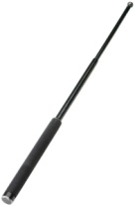
SIFT, by example
10 MHz
5 MHz
ADC
SIFT
SIFT
Data
ACK
Does not decode packets
Amplitude
SIFS
Pattern match in time domain
Time

