Slide 1
Wireless Networking
Nick Feamster
CS 6250
Fall 2011

Slide 2
What is a Wireless Network?
Wireless: without wires
Many ways to communicate without wires
  Optical
  Acoustic
  Radio Frequency (RF)
Many possible configurations
  Point-to-point (e.g., microwave communications links)
  Point-to-multipoint (e.g., cellular communications)
  Ad-hoc, (e.g., sensor networks)

Slide 3
Wireless Communications Networks
Wireless LANs: 802.11
Cellular Networks
  2G, 3G, 4G Networks
  Voice and data (e.g., EVDO)
Point-to-Point Microwave Networks
Satellite Communications
Short-Range: Bluetooth, etc.
Ultra-wideband Networks

Slide 4
Differences from the Wired Network
Sharing and resource management
  Wired network: no interference below network layer
  Wireless networks: interference can occur at the physical layer
Closest analog in the wired network: Ethernet on a hub-based network
  Difference: Collision detection easier in wireless network

Slide 5
Challenges in Wireless Networking
Resource sharing
Routing
  Challenge: coping with probabilistic packet reception
Achieving high throughput
  Challenge: determining capacity of a wireless network
Mobility
TCP performance
Energy-efficiency

Slide 6
Carrier Sense Multiple Access (CSMA)
Listen to medium and wait until it is free
(no one else is talking)
Wait a random backoff time
Advantage: Simple to implement
Disadvantage: Cannot recover from a collision

Slide 7
Wireless Interference
Two transmitting stations interfere with each other at the receiver
Receiver gets garbage
A
B
C

Slide 8
Carrier Sense Multiple Access with Collision Detection (CSMA-CD)
Procedure
  Listen to medium and wait until it is free
  Start talking, but listen to see if someone else starts talking too
  If collision, stop; start talking after a random backoff time
Used for hub-based Ethernet
Advantage: More efficient than basic CSMA
Disadvantage: Requires ability to detect collisions
  More difficult in wireless scenario

Slide 9
Collision Detection in Wireless
No “fate sharing” of the link
  High loss rates
  Variable channel conditions
Radios are not full duplex
  Cannot simultaneously transmit and receive
  Transmit signal is stronger than received signal

Slide 10
Solution: Link-Layer Acknowledgments
Absence of ACK from receiver signals packet loss to sender
Sender interprets packet loss as being caused by collision
Problem: Does not handle hidden terminal cases.

Slide 11
Carrier Sense Multiple Access with Collision Avoidance (CSMA-CA)
Similar to CSMA but control frames are exchanged instead of data packets
  RTS: request to send
  CTS: clear to send
  DATA: actual packet
  ACK: acknowledgement

Slide 12
Carrier Sense Multiple Access with Collision Avoidance (CSMA-CA)
Small control frames lessen the cost of collisions (when data is large)
RTS + CTS provide “virtual carrier sense”
    protects against hidden terminal
A
B

Slide 13
Random Contention Access
Slotted contention period
  Used by all carrier sense variants
  Provides random access to the channel
Operation
  Each node selects a random backoff number
  Waits that number of slots monitoring the channel
  If channel stays idle and reaches zero then transmit
  If channel becomes active wait until transmission is over then start counting again

Slide 14
Virtual Carrier Sense
Provided by RTS & CTS
Prevents hidden terminal collisions
Typically unnecessary
RTS
CTS
A
B
C

Slide 15
Physical Carrier Sense Range
Carrier can be sensed at lower levels than packets can be received
  Results in larger carrier sense range than transmission range
  More than double the range in NS2 802.11 simulations
Long carrier sense range helps protect from interference
Receive Range
Carrier Sense Range

Slide 16
Hidden Terminal Revisited
Virtual carrier sense no longer needed in this situation
RTS
CTS
A
B
C
Physical Carrier Sense

Slide 17
Ad Hoc Routing
Every node participates in routing: no distinction between “routers” and “end nodes”
No external network setup: “self-configuring”
Useful when network topology is dynamic

Slide 18
Learning Routes
Source routing
  Source specifies entire route: places complete path to destination in message header
  Intermediate nodes just forward to specified next hop: D would look at path in header, forward to F
Destination-based routing
  Source specifies only destination in message header
  Intermediate nodes look at destination in header, consult internal tables to determine appropriate next hop

Slide 19
Comparison
Source routing
  Moderate source storage (entire route for each desired dest.)
  No intermediate node storage
  Higher routing overhead (entire path in message header, route discovery messages)
Destination routing
  No source storage
  High intermediate node storage (table w/ routing instructions for all possible dests.)
  Lower routing overhead (just dest in header, only routers need deal w/ route discovery)
Examples: DSR, AODV
Example: DSDV

Slide 20
DSDV
Just like distance vector routing protocols
Nodes learn paths that have a metric and a sequence number
  Prefer route with highest sequence number
  Among routes with equal sequence numbers, prefer route with lowest metric
Weighted settling time to prevent nodes from advertising a bad path too fast
Question: What change did ETX make to the DSDV implementation with regard to WST?

Slide 21
Key Question: Link Metric
Appropriate metric for computing paths?
What metric to assign for link costs?

Slide 22
Design goals
Find high throughput paths
Account for lossy links
Account for asymmetric links
Account for inter-link interference
Independent of network load (don’t incorporate congestion)

Slide 23
Minimum Hop Count
Basic Problem: Assumes links either work or don’t work
Consequences
  Maximize the distance traveled by each hop
  Minimizes signal strength -> Maximizes the loss ratio
  Uses a higher Tx power -> Increases interference
Arbitrarily chooses among same length paths
  Paper shows that paths of same length can have wildly varying throughputs

Slide 24
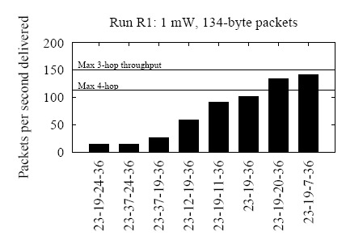
Throughput of Various Paths
Paths of the same length can have very different throughputs
Fewer hops does not mean better throughput

Slide 25
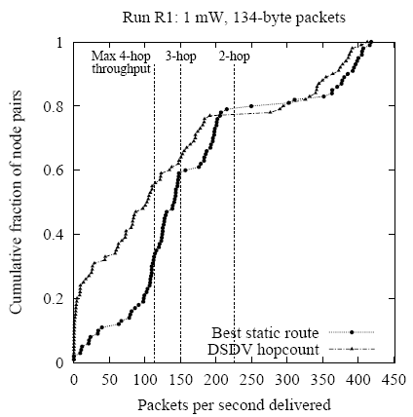
Throughputs Using Hop Count
Single-hop paths

Slide 26
Other Possible Metrics
Remove links according to a threshold loss rate
  Can create disconnections
Product of link delivery ratio along path
  Does not account for inter-hop interference
Bottleneck link (highest-loss-ratio link)
  Same as above
End-to-end delay
  Depends on interface queue lengths

Slide 27


ETX: Expected # of Transmissons
ETX: Expected number of transmissions to send packet over link or path (including retransmissions)
ETX (link) =
ETX(link)
  Measured in periodic probe packets
  Reverse ratio piggybacked in periodic probe packets
ETX (path) = ∑ ETX(link)

Slide 28
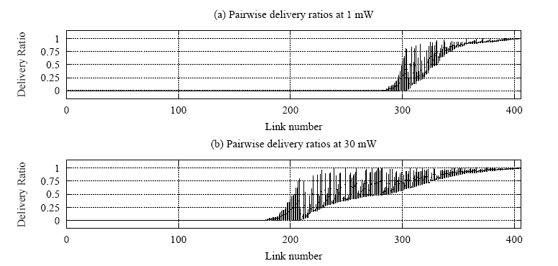
Measure Both Forward and Reverse
Link loss rates are highly asymmetric
Loss rate must be low in both directions to avoid retransmission

Slide 29
Caveats
Probe size ≠ Data/Ack size: ETX estimates are based on measurements of a single link probe size (134 bytes)
  Underestimates data loss ratios
  Overestimates ACK loss ratios
Assumes all links run at one bit-rate
Assumes radios have a fixed transmit power
Notes:
ETX link probes are susceptible to MAC unfairness and hidden terminals
Route ETX measurements change under load

Slide 30
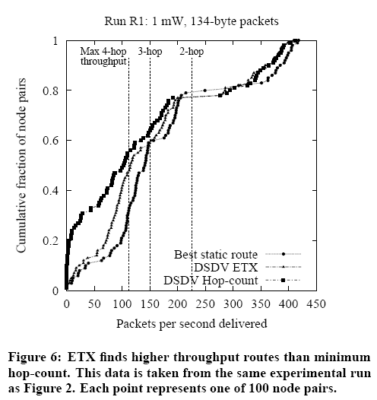
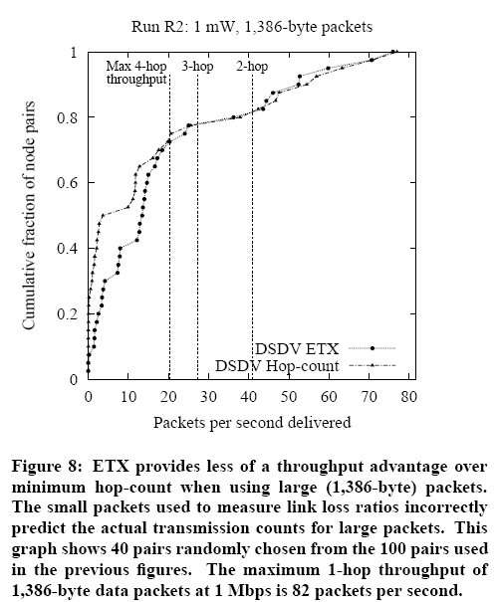
Evaluation: ETX vs. Hop Count

Slide 31
ETX Redux
Advantages
  ETX performs at least as well as hop count
    Accounts for bi-directional loss rates
  Can easily be incorporated into routing protocols
Disadvantages
  Must estimate forward and reverse loss rates
  May not be best metric for all types of networks

Slide 32
DSR Protocol Operation
Route discovery
  When source needs a route to a destination
Route maintenance
  When a link breaks, rendering path unusable
Routing

Slide 33
Route Discovery
Step #1: Source sends Route Request
  Source broadcasts Route Request message for specified destination
  Intermediate node
    Adds itself to path in message
    Forwards (broadcasts) message toward destination
Step #2: Destination sends Route Reply
  Destination unicasts Route Reply message to source
    will contain complete path built by intermediate nodes

Slide 34
Route Discovery: Route Request
B
<A,B>
<A,C,E>
<A>
E
G
<A,C,E,G>
<A,C>
<A>
source
A
C
H
destination
<A>
D
<A,D,F>
F
<A,D>

Slide 35
Route Discovery: Route Reply
B
E
G
A
C
H
<A,D,F>
<A,D,F>
D
F
<A,D,F>
Question: What change did ETX make to the DSR’s route reply?

Slide 36
Details
Problem: Overhead of route discovery
  Intermediate nodes cache overheard routes
  “Eavesdrop” on routes contained in headers
  Intermediate node may return Route Reply to source if it already has a path stored
Problem: Destination may need to discover route to source (to deliver Route Reply)
  Piggyback New Route Request onto Route Reply

Slide 37
Route Maintenance
Used when links break
  Detected using link-layer ACKs, etc.
Route Error message sent to source of message being forwarded when break detected
  Intermediate nodes “eavesdrop”, adjust cached routes
Source deletes route; tries another if one cached, or issues new Route Request

Slide 38
Initial approach: Traditional routing
packet
packet
A
B
packet
src
dst
C
Identify a route, forward over links
Abstract radio to look like a wired link
ExOR Slides adapted from http://pdos.csail.mit.edu/papers/roofnet:exor-sigcomm05/
Notes:
just say picks a route, fwd over that route

Slide 39
Radios aren’t wires
A
B
1
2
src
dst
2
2
3
3
3
4
4
4
5
5
5
6
6
1
6
1
2
3
4
5
6
1
C
Every packet is broadcast
Reception is probabilistic
Notes:
what’s really going on is we’re abstracting → as youall know, radios don’t work like links

Slide 40
ExOR: Probabilistic Broadcast
packet
packet
packet
packet
A
B
src
dst
packet
packet
packet
packet
packet
C
Decide who forwards after reception
Goal: only closest receiver should forward
Challenge: agree efficiently and avoid duplicate transmissions
Notes:
say there’s an opportunity here, take advantage of bcast. spell it out: closest node should reduce the number of tx to get to dest. challenge:: key failure is that two people should not forward. make sure only one guy forwards

Slide 41
Why ExOR might increase throughput
src
N1
N2
N3
N4
N5
dst
75%
50%
25%
Best traditional route over 50% hops: 3(¹/_{0.5}) = 6 tx
Throughput ≅ ¹/_{# transmissions}
ExOR exploits lucky long receptions: 4 transmissions
Assumes probability falls off gradually with distance
Notes:
new slide earlier, assume figured out design. explore why exor might improve throughput/develop a feel title -> why exor might beat trad routing.
inverse prop to #trans, up to 4 hops

Slide 42
Why ExOR might increase throughput
N1
25%
100%
N2
25%
100%
src
dst
25%
N3
100%
25%
100%
N4
Traditional routing: ¹/_{0.25} + 1 = 5 tx
ExOR: ¹/(1 – (1 – 0.25)⁴) + 1 = 2.5 transmissions
Assumes independent losses
Notes:
say this is a contrived example

Slide 43
Batch Maps
rx: 0
rx: 40
rx: 57
rx: 85
tx: 0
N2
N4
tx: 100
tx: 57 -23
≅ 24
rx: 0
tx: ≅ 9
rx: 22
src
dst
rx: 88
rx: 99
rx: 23
N1
N3
rx: 53
tx: ≅ 8
tx: 23
Challenge: finding the closest node to have rx’d
Send batches of packets for efficiency
Node closest to the dst sends first
  Other nodes listen, send remaining packets in turn
Repeat schedule until dst has whole batch
Notes:
add circle for source, then some more circles showing next iteration (no rx/tx numbers). say at the end, packets go through multiple iteration. add source, add n4.

Slide 44
Reliable summaries
tx: {2, 4, 10 ... 97, 98}
summary: {1,2,6, ... 97, 98, 99}
N2
N4
src
dst
N1
N3
tx: {1, 6, 7 ... 91, 96, 99}
summary: {1, 6, 7 ... 91, 96, 99}
Repeat summaries in every data packet
Cumulative: what all previous nodes rx’d
This is a gossip mechanism for summaries
Notes:
just say we incude a summary in every packet
repeated
cumulative
simplify: every node is listening, include list to make it more robust

Slide 45
Priority ordering
N2
N4
src
dst
N1
N3
Goal: nodes “closest” to the destination send first
Sort by ETX metric to dst
  Nodes periodically flood ETX “link state” measurements
  Path ETX is weighted shortest path (Dijkstra’s algorithm)
Source sorts, includes list in ExOR header
Details in the paper
Notes:
source calculates path etx for each node to dest, talk about dijkstra, sort by lowest etx

Slide 46
ExOR Evaluation
Does ExOR increase throughput?
When/why does it work well?

Slide 47
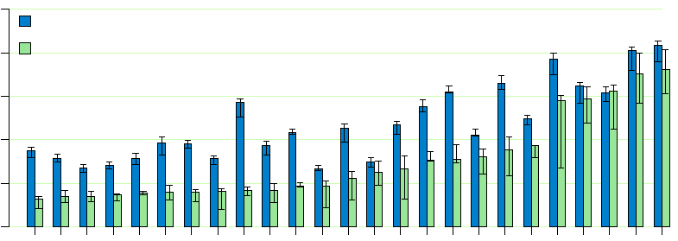
25 Highest throughput pairs
3 Traditional Hops
2.3x
2 Traditional Hops
1.7x
1 Traditional Hop
1.14x
1000
ExOR
800
Traditional Routing
600
Throughput (Kbits/sec)
400
200
0
Node Pair
Notes:
for the two hop, say we can have more intermediate hops like ex 2 or make it all the way

Slide 48
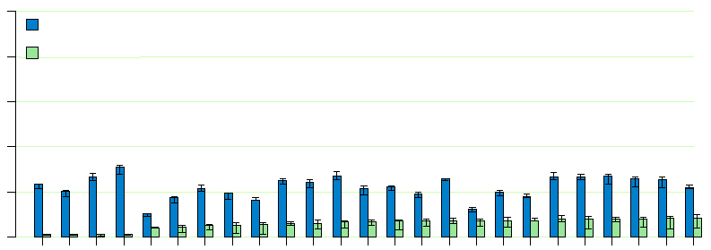
25 Lowest throughput pairs
1000
ExOR
4 Traditional Hops
3.3x
800
Traditional Routing
600
Throughput (Kbits/sec)
400
200
0
Node Pair
Longer Routes
Notes:
etx was forced to use asymmetric links. robust batch maps.

Slide 49
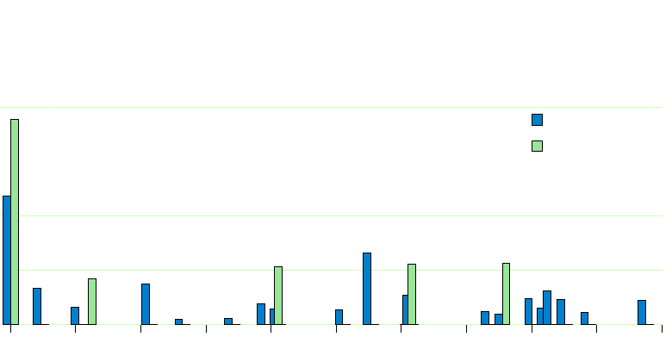
ExOR moves packets farther
58% of Traditional Routing transmissions
0.6
ExOR
Traditional Routing
Fraction of Transmissions
0.2
25% of ExOR transmissions
0.1
0
0
100
200
300
400
500
600
700
800
900
1000
Distance (meters)
ExOR average: 422 meters/transmission
Traditional Routing average: 205 meters/tx
Notes:
lower is better. right circle – using lots of longer links, sum them up and it’s 25%. so, like ex 1, using lots of long links. zeros: before many packets made no progress, with exor at least some.

Slide 50

ExOR In Practice
See http://www.meraki.net/ for details
Low power mesh radios, ExOR as the basis

Slide 51
Rural Wireless Mesh Networks (WMNs)‏
A mesh network comprised of multiple, commodity devices that provides Internet access to rural areas
Topology differs from hub-and-spoke wireless networks
Applications: Education, health care
Benefits: cost, robustness, infrastructure requirement
Notes:
51

Slide 52
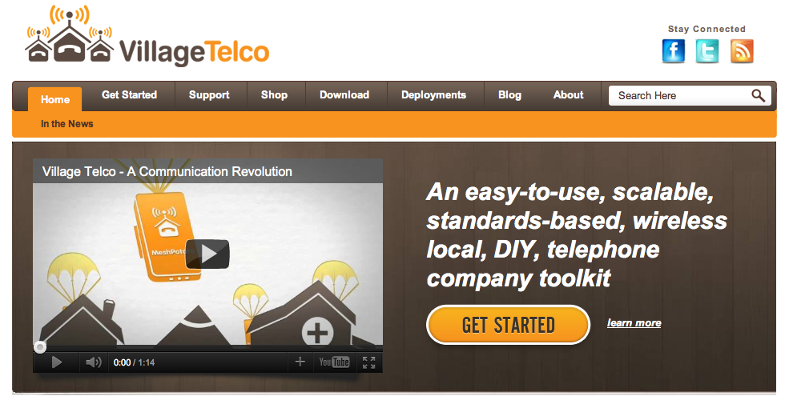

Slide 53
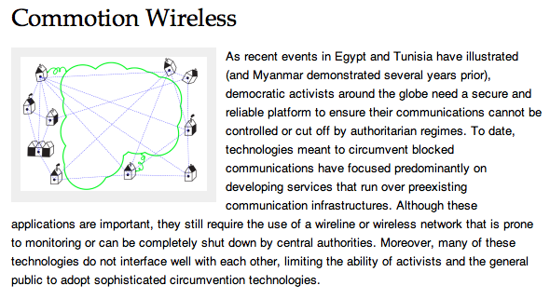

Slide 54
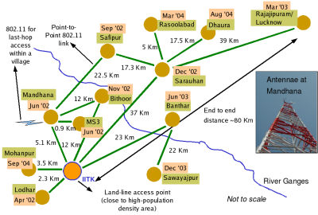
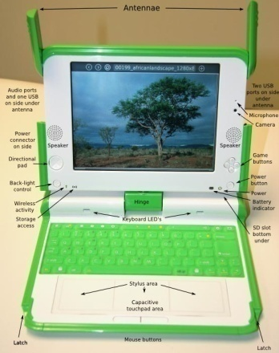
Introduction: Rural WMN Examples
Digital Gangetic Plains (India)‏
OLPC Project:
Each XO-1 will operate as a WMN node
Image from http://www.cse.iitk.ac.in/users/braman/dgp.html
Image from
http://laptop.org/en/laptop/hardware/specs.shtml
Notes:
54

Slide 55
B.A.T.M.A.N.(1)‏
A
B
F
D
G
C
X
E
A wants to reach X

Slide 56
B.A.T.M.A.N. (2)‏
A:10
A
B
F
A:9
D
G
C
X
E
Nodes broadcast originator messages (OGM's) every second
OGM's are rebroadcast
Other nodes measure how many OGM's are received in a fixed time window

Slide 57
B.A.T.M.A.N. (3)‏
A
B
F
A:8
D
G
C
A:7
X
A:7
E
D BATMAN routing table
TO VIA Q
A B 8
A C 7
D Final routing table
TO VIA
A B

Slide 58
B.A.T.M.A.N. (4)‏
A
B
F
A:0
D
A:6
G
C
A:4
X
A:7
E
G BATMAN routing table
TO VIA Q
A D 6
A E 7
G Final routing table
TO VIA
A E

Slide 59
B.A.T.M.A.N. (5)‏
A
B
F
D
G
A:5
C
X
A:6
E
X BATMAN routing table
TO VIA Q
A G 5
A E 6
X Final routing table
TO VIA
A E

Slide 60
B.A.T.M.A.N. (6)‏
A
B
F
D
G
C
X
E
X BATMAN routing table
TO VIA Q
A G 5
A E 6
E BATMAN routing table
TO VIA Q
A C 7
A D 4
C BATMAN routing table
TO VIA Q
A A 9

Slide 61
Current GW selection techniques
GW2
Minimum hop count to gateways
Used by routing protocols like AODV
Creates single over congested gateways
A
B
F
D
C
G
X
E
GW1

Slide 62
Current GW selection techniques
GW2
Best link quality to GW
Used by
  source routing protocols like MIT Srcr
  Link state protocols like OLSR
Prevents congested links to GW
Not global optimum of GW BW usage
2
2.2
A
B
F
1.5
1
1
3
D
C
G
1
X
1
1
E
GW1

Slide 63
Current GW selection techniques
256 kbps
GW2
BATMAN has advanced a little further
GW can advertise downlink speed
User can choose GW selection based on
  GW with best BW
  Stable GW (need history)‏
  GW_{BW} x LQ
Can't trust advertised GW BW
Doesn't achieve fairness
9
10
A
B
F
7
4
7
3
D
C
G
8
7
X
E
10
512 kbps
GW1

